Slide 1
2019 Initiatives, Capacity, Impact
Innovation & Technology
Sep 13th, 2018

Slide 2
2019 Finance Plan vs ICI Forecast
NIE (I&T + Transformation) | 2017 Actual | 2018 Plan (original) | 2018 Target (Q3F) | Aug 18 YTD Actual | 2018 Emerging | 2018 Oct exit run rate | 2019 Plan | 2019 Ask (ICI) |  | FTE (I&T + Transformation) | 2017 Actual | 2018 Plan (original) | 2018 Target (Q3F) | Aug 18 YTD Actual | 2018 Emerging | 2019 Plan | 2019 Ask (ICI)
WMTS (Rick) | $ 186.2 | $ 219.7 | $ 221.9 | $ 183.4 | $ 222.5 | $ 235.4 | $ 247.2 | $ 239.2 |  | WMTS (Rick) | 539 | 631 | 617 | 582 | 597 | 661 | 617
DNA (Neil) | $ 107.6 | $ 115.7 | $ 126.6 | $ 111.6 | $ 136.8 | $ 146.9 | $ 142.6 | $ 221.9 |  | DNA (Neil) | 294 | 316 | 305 | 347 | 356 | 363 | 475
DevOps, RPA (Mike) | $ 21.9 | $ 23.5 | $ 23.0 | $ 19.3 | $ 23.7 | $ 26.5 | $ 24.9 | $ 27.0 |  | DevOps, RPA (Mike) | 66 | 75 | 76 | 80 | 79 | 82 | 82
Architecture (Alex) | $ 21.9 | $ 15.3 | $ 11.4 | $ 9.7 | $ 11.8 | $ 12.6 | $ 11.2 | $ 16.0 |  | Architecture (Alex) | 55 | 62 | 49 | 51 | 52 | 49 | 68
Innovation, Blockchain (Alex) | $ 6.4 | $ 8.4 | $ 6.8 | $ 5.7 | $ 6.9 | $ 7.4 | $ 7.8 | $ 8.0 |  | Innovation, Blockchain (Alex) | 25 | 36 | 30 | 40 | 41 | 34 | 46
Cloud (Ranji) (**) | $ 10.1 | $ 17.8 | $ 19.5 | $ 15.3 | $ 18.7 | $ 21.6 | $ 21.8 | $ 37.7 |  | Cloud (Ranji) | 26 | 49 | 32 | 27 | 34 | 40 | 61
UK transit (*) | $ 2.2 | $ 1.9 | $ 2.8 | $ 1.9 | $ 2.3 | $ 2.7 | $ 3.2 | $ 3.2 |  | UK transit (*) | 4 | - | 5 | 4 | 5 | 5 | 5
QE (Shohreh) | $ 2.5 | $ 5.5 | $ 5.0 | $ 4.4 | $ 5.5 | $ 6.9 | $ 5.6 | $ 6.4 |  | QE (Shohreh) | 14 | 23 | 21 | 23 | 23 | 21 | 23
Central/Other | $ 9.0 | $ 10.1 | $ 5.4 | $ (1.1) | $ (1.7) | $ (3.4) | $ 0.9 | $ 0.9 |  | Central | 12 | 13 | 12 | 12 | 12 | 12 | 12
Total I&T & Transformation | $ 367.8 | $ 417.9 | $ 422.4 | $ 350.2 | $ 426.5 | $ 456.7 | $ 465.2 | $ 560.3 |  | Total I&T & Transformation | 1,035 | 1,205 | 1,147 | 1,165 | 1,199 | 1,267 | 1,389
I&T | $ 345.5 | $ 377.1 | $ 382.3 | $ 314.4 | $ 381.7 | $ 407.3 | $ 422.5 |  |  | I&T | 913 | 1,066 | 1,034 | 1,029 | 1,062 | 1,151
Transformation | $ 22.3 | $ 40.8 | $ 40.1 | $ 35.9 | $ 44.8 | $ 49.3 | $ 42.6 |  |  | Transformation | 122 | 139 | 113 | 137 | 137 | 117
Total I&T & Transformation | $ 367.8 | $ 417.9 | $ 422.4 | $ 350.2 | $ 426.5 | $ 456.7 | $ 465.2 | $ 560.3 |  | Total I&T & Transformation | 1,035 | 1,205 | 1,147 | 1,165 | 1,199 | 1,267 | 1,389
Delta to be addressed |  |  |  |  | $ (4.1) |  |  | $ (95.2) |  | Delta to be addressed |  |  |  |  | (52) |  | (122)
(*) includes UK transit for previous Cloud leadership team and architects in the UK. Approx. $3.2mm for 5 FTE |  |  |  |  |  |  |  |  |  | (*) includes UK transit for previous Cloud leadership team and architects in the UK. Approx. $3.2mm for 5 FTE
(**) includes consumption costs for Bluemix, AWS, PCF which are being discussed for transfer to GTI with Plan

Slide 3
WM AppDev Breakout
Wealth Management Application Development C$mm | 2018 T&O Target | 2018 Business Demand | 2019 T&O Plan | 2019 Business Demand | 2019 Target Proposed @ GE
Non-US | 95 | 95 | 95 | 105 | 95
US | 75 | 77 | 92 | 100 | 92
CNB | 4 | 4 | 8 | 10 | 8
Total | 173 | 175 | 195 | 215 | 195

Slide 4
WMTS $mm | 2018 F (MIS) | 2019 P | YoY
WM Development:
Non-US | 81.9
US | 75.9
CNB | 0.4
Unbilled work | 4.4
Sub-total | 162.6 | 191.6 | 29.0
WM Maintenance:
Non-US | 27.7
US | 20.5
Sub-total | 48.2 | 52.5 | 4.3
Other business:
P&CB | 7.5
Capital Markets | 1.8
Insurance | -
I&TS | 0.4
Functions | 1.6
T&O | 0.1
Sub-total | 11.4 | 11.4 | -
Total (using MIS 2018) | 222.2 | 255.5 | 33.3
Q3F as at May ‘18 | 226.1 | 259.4 | 33.3

Slide 5
Opportunities for Synergies and Collaboration
DNA
Driving Data Science at Scale – opportunities for cost reduction
Trim # of labs down – approx 20 maybe 15
Extending the RBC Data Landscape – synergy with WMTS (ex. C360)
Get plan from P&CB - to fall under Rick's plan, doesn't need to cost/plan in DNA
Architecting the Next Gen Data Environment – Collaboration with cloud: goal is to get on public cloud in 12 months
Needed to move forward with technology and opportunities in cloud
Next Gen data lake on the cloud
Unlocking Business Value from Insights – Synergy with CDO + many more opportunities
Collaboration opportunities with Innovation (ex. Recommender engine + no model left behind)
Collaboration with RPA – automation with Devops and AI Devops
Opportunities - AI software
DevOps
DevOps Development and Services – collaboration with Cloud
Automation Solutions Engineering – collaboration with QE
Process Automation – collaboration with DNA and WMTS
Agile CoE – synergy with WMTS (federation of Agile coaches)
Quality Engineering
Environment engineering – synergy with DevOps (mainly test env), could involve potential collaboration with everyone
Monitoring & Analytics – synergy with Devops +GTI
Tools & Framework Engineering – synergy with Devops
Enterprise Software – Need full list. Potential opportunity with chargeback model
Cloud
Runtime as a Service – lots of synergy opportunities with Devops
Rick to send Ranji: list of programs, projects impacted (ex. OMNI, Journey 1+2)
Search as a Service – synergy with Devops on Security
Public cloud – synergy with Dev productivity
Synergy with EA and Security
Innovation
Strategy & Operations – synergies with all LOBs , in interest of collaboration (not necessarily cost savings)
Enterprise Architecture
Synergies for Next Gen with DNA on Security
Reuse @ Scale – collaboration with Cloud

Slide 6

Wealth Management
Technology & Solutions
WMTS Business Plan by Capability 2019
Rick Hariman
September 11, 2018

Slide 7
2019 WM BU Plan
Wealth Management
Technology & Solutions
- WM Plan of $251.5 translates to a WMTS Plan of $249.4 (example below)
$249.4 – Total WMTS

Slide 8
2019 WMTS Financial
Wealth Management
Technology & Solutions
LOB | Carryover | New - Must Do | New - Should Do
Non-US
WMC | $16.24 | $17.35 | $4.8
O&T Can Ops | $5.5 | $3.05 | $8.55
O&T Global | $3.2 | $1.85 | $6.15
O&T S&S | $0.67 | $4.92 | $0.4
WMI | $3.41 | $4.09 | $0
WMA | $2.4 | $2.7 | $0
P&S | $.3.15 | $5.0 | $0.9
GAM | $11.47 – In Process of Prioritization
US
US | $9.7 | $97 – In Process of Prioritization

Slide 9

Wealth Management
Technology & Solutions
I&T Collaboration - WMTS & DNA
Preliminary Analysis underway to see if there are areas between the 2 groups that can leveraged.
Resources with Kafka, Java, & potentially Spark skillsets could be used on the following WM Initiatives producing ~$2mm in Savings
Glass
COB
myDiscovery
myGPS
Next Steps:
1. WMTS Data Team to meet with Neil (DNA) about leveraging skillsets.
Do they exist?
Do they have capacity?
If so, when?
How does this fit into our Demand and Timelines?
2. Opposite question - Ask Neil about leveraging existing resources from the WMTS Data Team to assist with DNA current demand

Slide 10
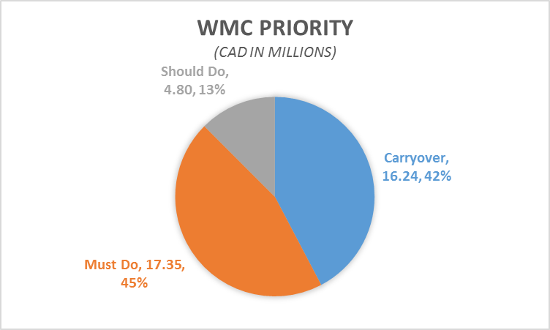
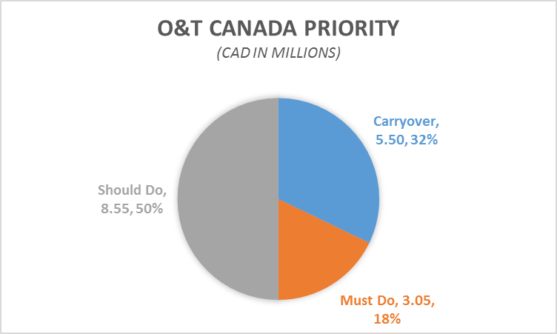
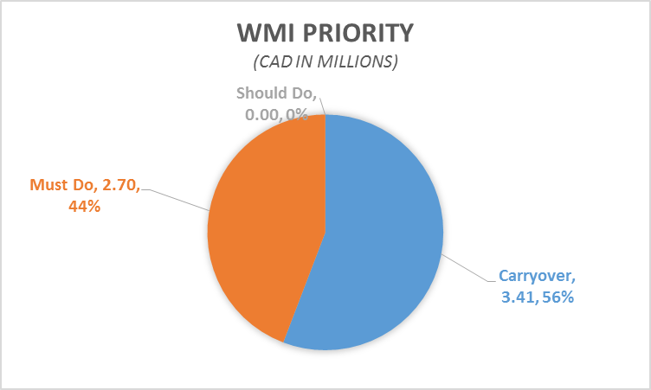
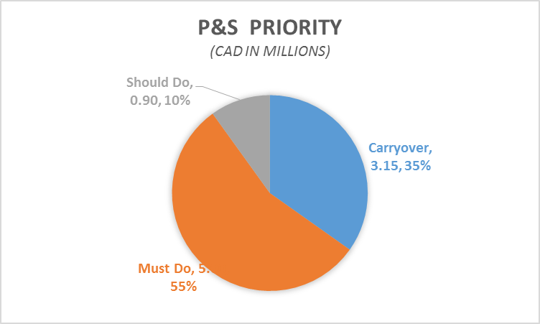
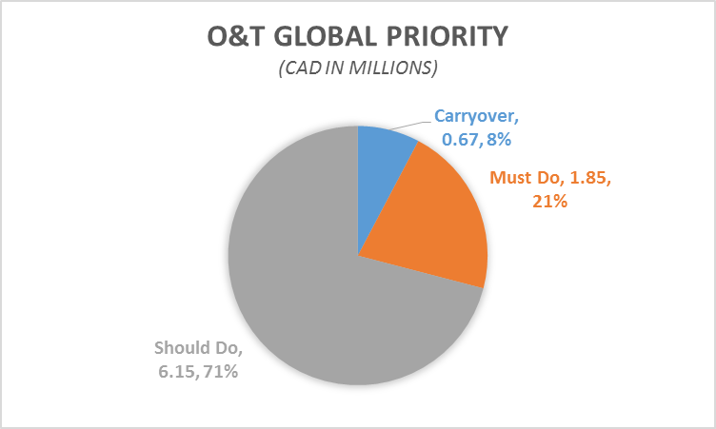
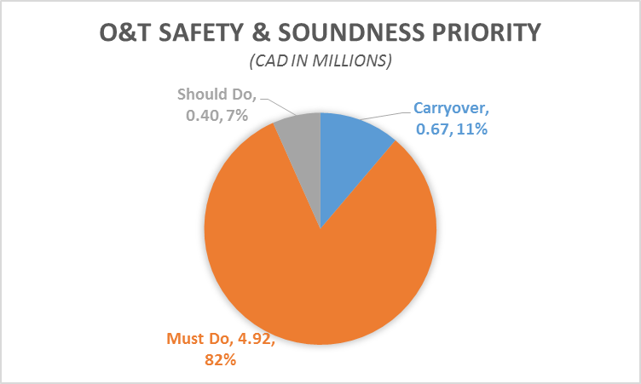
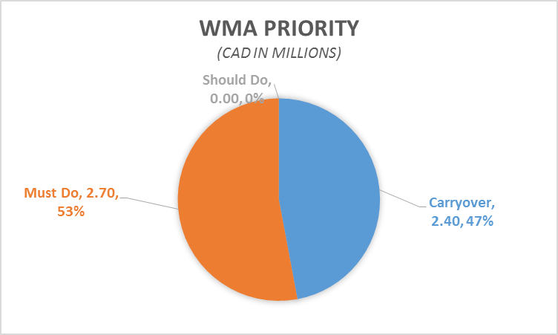
Prioritization of Projects – by LOB
Wealth Management
Technology & Solutions
LOB Priority Breakdown
Unavailable Data:
WMUS
GAM

Slide 11
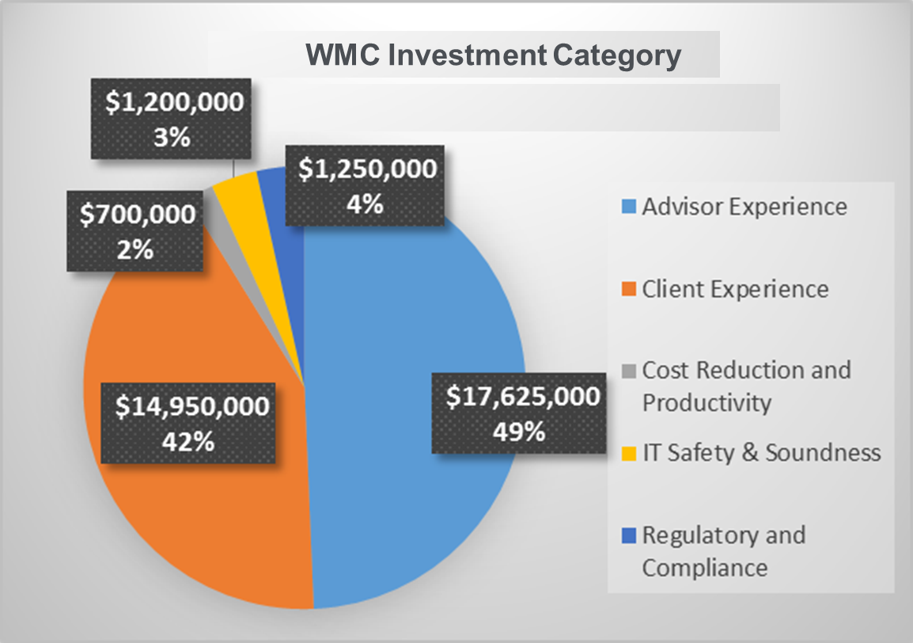
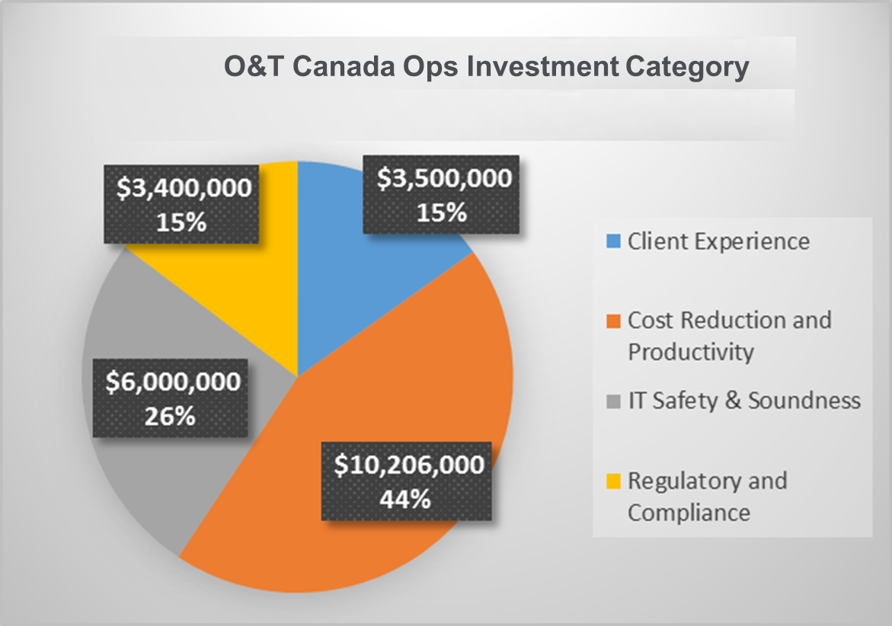
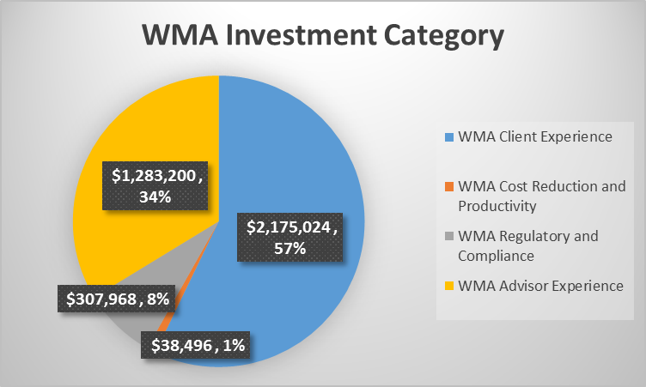
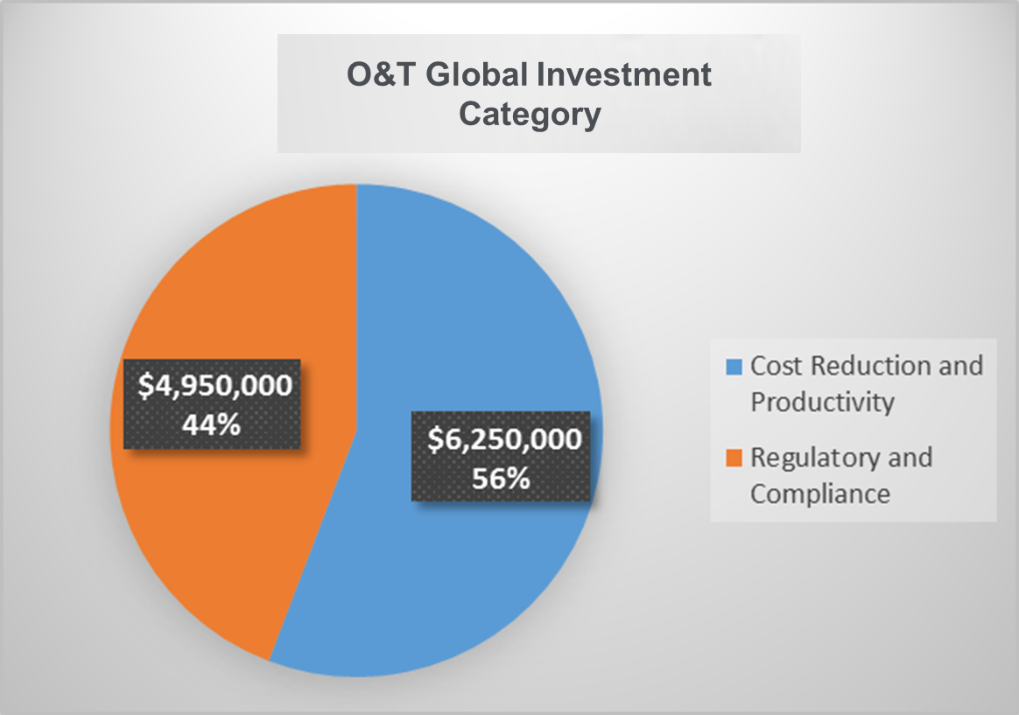
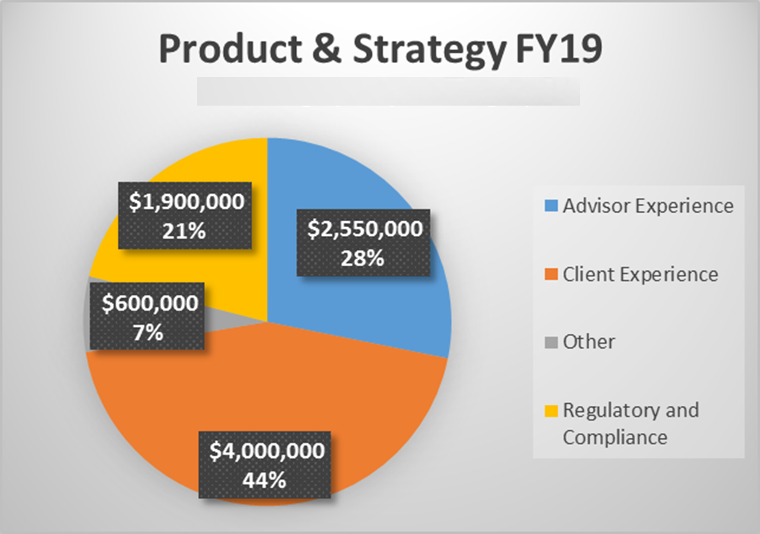
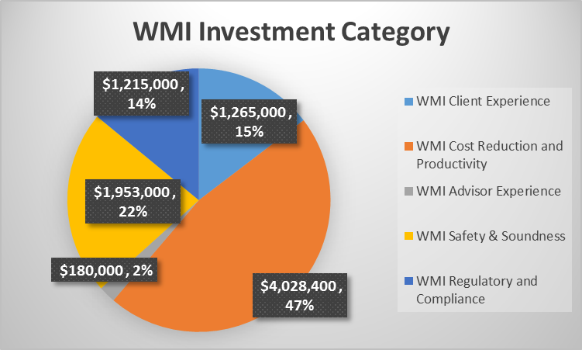
Prioritization of Projects – by Investment Category
Wealth Management
Technology & Solutions
LOB Investment Category Breakdown
Unavailable Data:
WMUS
GAM

Slide 12
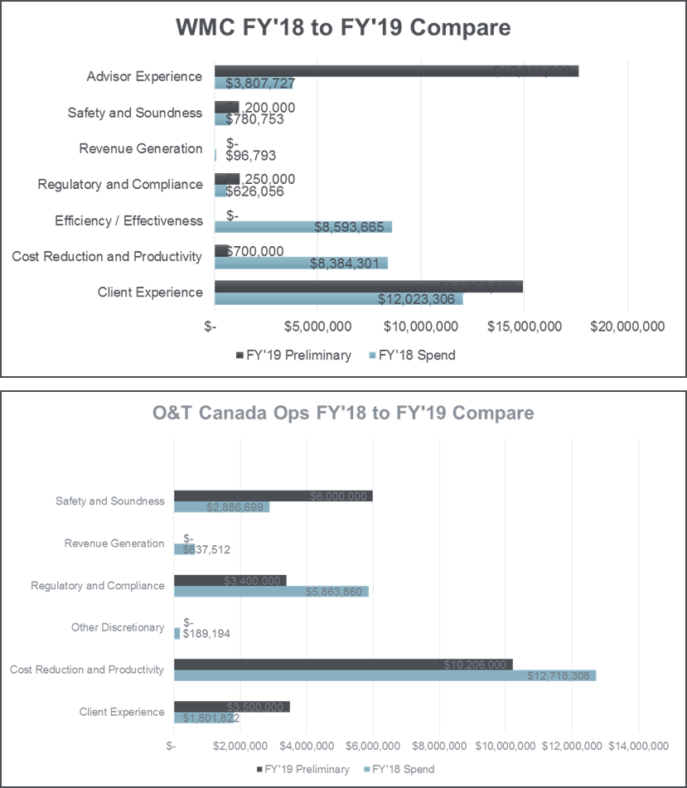
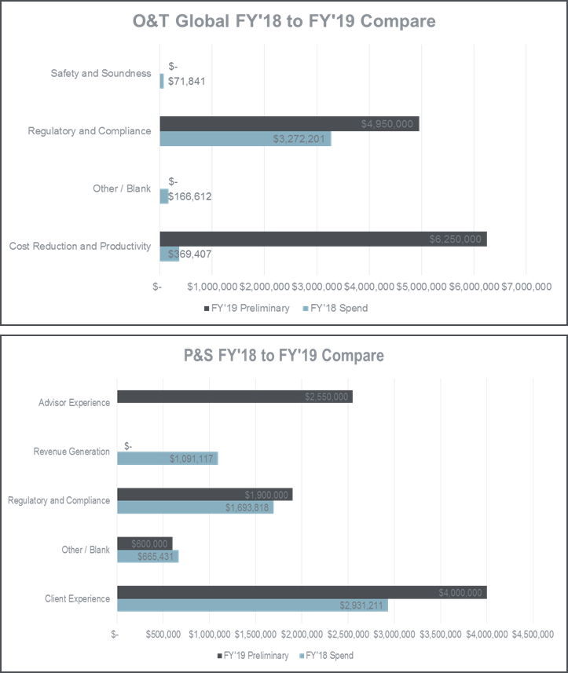
2018 to 2019 Investment Category Comparison

Slide 13
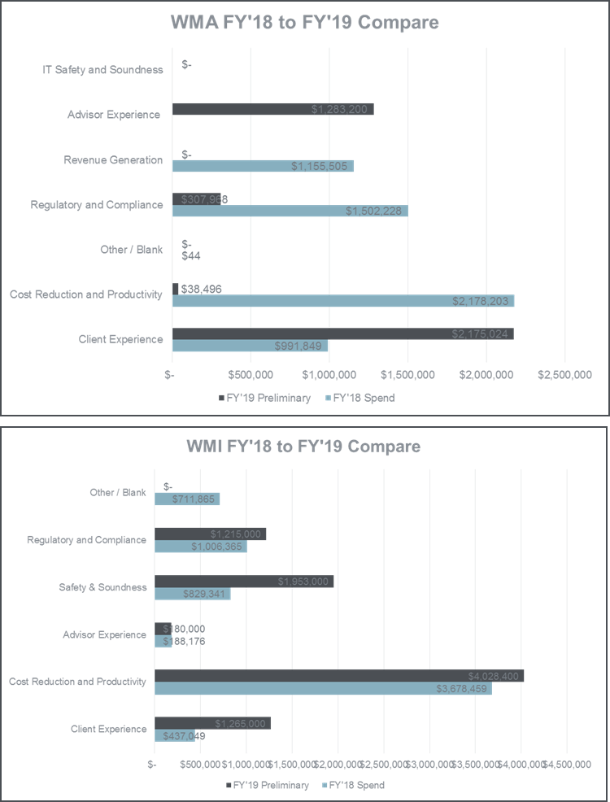
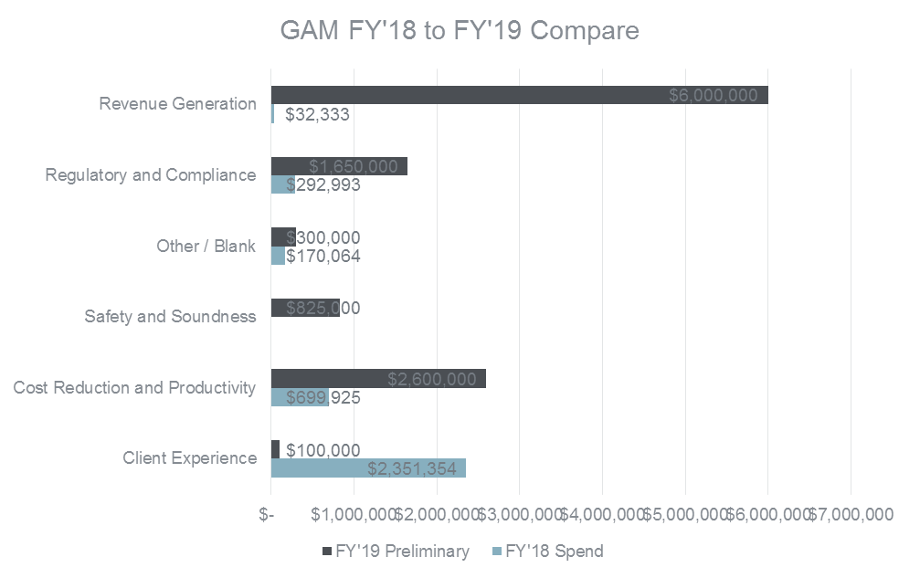
2018 to 2019 Investment Category Comparison
Awaiting on USWM

Slide 14
WMUS 2019 Business Plan by Capability
(Projects List in progress by US Business & Technology)
Wealth Management
Technology & Solutions
Initiative [Project] | Impact | Capacity | Synergy
Client & Advisor Channels | Public Sites/Social Client Mobile Client Online Advisor Mobile Branch/Desktop Call Centre | Total Estimate $19 CAD | Common Solution Us & Canada: AVA
Client/Advisor Engagement | Client Prospecting Client Onboarding Client Reporting Goals-based Wealth Management Product Fulfillment Order & Trade Management Client Servicing & Management Advisor Prospecting & Onboarding Advisor Business Management | Total Estimate $26 CAD | Common Solution US & Canada: Clientview US is exploring COB solution being built in Canada
Products & Advisory Solutions | Advisory Products Packaged Solutions Credit & Cash Management Insurance Alternative Investments | Total Estimate $22 CAD | Common Solution US & Canada: Envestnet, Portfolio Management, COMS Credit
Back Office & Shared Services | Operations/Back Office Processing Risk Management Data & Content Management Analytics & Intelligence Security & Privacy Services (API-based technology) Workflow Management Infrastructure Services | Total Estimate $25 CAD | Common Solution US & Canada: Wokflow (Pega), Broadridge Common Services: ISL, GIS (Mid-tiers) on Apigee US is exploring Datahub solution, being built in Canada
Other | USWM City National Integration Other | Total Estimate $6.5 CAD | CNB is exploring USWM Online Mobile and Dual Client Experience
 | Total Business Plan | $95 CAD
City National | City National | Total Estimate $8 CAD | NOTE: AIRB project under Al Tinney
Note: USWM Agreed to change to $95M CAD and looking to reduce further

Slide 15
WMC 2019 Business Plan by Capability
Wealth Management
Technology & Solutions
Initiative [Capabilities] | Impact |  | Capacity | Synergy
Portfolio Management | A+ Fee Migration A+ Type 2 and 9 Accounts Asset Class Alignment ClientLink 2019 Agile Project (TRACS_ Envestnet 2018 FY2019 ClientLink Data Integrity Enhancements IPS Toolkit Enhancements Market Data Review Initiative | PIM/Advisor/A+/DSTFSA Charge account change Portfolio Management & Fee Management Capability Investment Risk Management Dashboard TAC 3.0 Enhancements Wealth Suite Execution Wealth Suite POC | Total Estimate $9.9 | Integration with a Fee Management solution that is investment portfolio/household driven across WMC Common Solution US & Canada: Envestnet Collaboration with Cloud COE on TAC 3.0 Enhancements in PCF Common Solution to consolidate all portfolio management systems in Canada (DS, PHN, E&T)
Data Management | Branch Hierarchy GUI (Phase 2) |  | Total Estimate $0.65 CAD | Strive to have all data across WMC centralized, governed, and curated for downstream systems and processes. Continued focus to identify synergies across data needs.
Client Servicing | WMC Online (InvestCloud) |  | Total Estimate $3 CAD | Common Services: Online Banking Security, Messaging, Document Vault
Branch Management Experience | AEQ ADV2B & IPS Enhancements GSS Portfolio Surveillance and Reporting Enhancements |  | Total Estimate $1.6 CAD | Investment and Regulatory surveillance performed at the client level vs. individual account level for greater efficiency and more meaningful client experience
Advisor Business Management | Branch Hierarchy GUI (Phase 1) Simplified Desktop (Glass) |  | Total Estimate $1.6 CAD | US will explore Simplified Advisor Desktop
Client Servicing & Reporting | Client Reporting Capability Custody Overhaul External Design Standards |  | Total Estimate $5 CAD | Centralizing relevant data to create ‘so what’ and regulatory reporting
Relationship Management | Relationship and Opportunity Management |  | Total Estimate $2.5 CAD | Common Solution in US & Canada: Clientview
Foundational | Base Essential Enhancements Data Capability |  | Total Estimate $3.1 CAD
Wealth Planning | Wealth Planning Capability Investment (myDiscovery, myGPS) |  | Total Estimate $3.0 CAD | Having the client discovery phase fully integrated with CRM and account opening systems and processes.
Client & Account Opening & Client Onboarding and Admin | Client Onboarding DS Global eKYC, Content Manager, etc. FY2019 eKYC Enhancements |  | Total Estimate $7.1 CAD | COB will leverage Enterprise e-signature Common Services: Simplified Desktop, WMC Online, AVA
 | Total Business Plan |  | $36.8 CAD

Slide 16
Combined O&T Canada & Global 2019 Business Plan by Capability
Wealth Management
Technology & Solutions
Initiative [Capabilities] |  | Impact |  | Capacity | Synergy
O&T Canada Business Capabilities | Asset Services | Asset Transfer Digitization Voluntary Corporate Actions STP (BPM – Re-org)* |  | Total Estimate $0.3
 | Portfolio Management | Fee Billing Consolidation |  | Total Estimate $1.5 CAD | Common Solution to consolidate all portfolio management systems in Canada (DS, PHN, E&T)
 | Cash Management | Payments Transformation – Capital Markets |  | Total Estimate $0.55 CAD | Collecting information as planning finalizes
 | Reference Data Management | Market Data Review Initiative IT Safety & Soundness/Technology Currency |  | Total Estimate $6.2 CAD | Collecting information as planning finalizes
 | Clearing and Settlement | FundSERV 28 |  | Total Estimate $0.8 CAD | Collecting information as planning finalizes
 | Trade Management & Support | CDIC Reg. Changes – GIC/HICA Mutual Fund Trade Modernization* |  | Total Estimate $2.1 CAD | Collecting information as planning finalizes
 | Client Reporting | CRA Regulatory Changes to Registered Charge Accounts* CRM2 Additional Report Composition Changes – Day 3 Changes DataPro Single Sign-on | Futures ClientSource Update TFP (Tax Form Plus) Migration* US Reg. – 871M US Hire Act* WM Tax Reporting Changes/ZCBA Reporting | Total Estimate $5.75 CAD | Centralizing relevant data to create ‘so what’ and regulatory reporting
 | Client Onboarding & Admin | Account Range Transformation Phase 2 BFS Enhancements Business Process Optimization | Fee Billing Enhancements Operational Optimization Enhancements | Total Estimate $5.9 CAD | Collecting information as planning finalizes
O&T Global Business Capabilities | Access Management | IAM – Phase 2* |  | Total Estimate $2.5 CAD
 | Client Servicing | Project Titan (NDA)* |  | Total Estimate $0.1 CAD | Asia & Canada Ops Consolidation
 | Asset Services | Asset Servicing Strategic End State |  | Total Estimate $2.5 CAD
 | Ops Services | Next Generation Optimization |  | Total Estimate $0.8 CAD | RPA-AI collaboration with COE- ServiceLink special handling (freeform texts)
 | Client Onboarding & Admin | SATURN (NDA) |  | Total Estimate $0.6 CAD | Collecting information as planning finalizes
 | Reference Data Management | Data Hub Foundational (Delivery of new WM Data Core) WM Data Governance |  | Total Estimate $1.8 CAD | Collecting information as planning finalizes
 | Client Reporting | WMA PB Ops – Corporate Actions WMA PB Ops – Reconciliations WMA PB Ops – Broker Trade WMA PB Ops – Tax Reporting Efficiency | WMA PB Ops – Statement & Advice Outsourcing Coon Reporting Standards | Total Estimate $1.6 CAD | Centralizing relevant data to create ‘so what’ and regulatory reporting
 |  | Total Business Plan |  | $34.3 CAD
* indicates carry over

Slide 17
Combined WMI/WMA/GAM 2019 Business Plan by Capability
Wealth Management
Technology & Solutions
Initiative [Capabilities] |  | Impact | Capacity | Synergy
WMI |  | JSFC – Risk-based Supervision Payments Service Directive (PSD 2) Cees Client Accounting Cees ESOP/JPUTS solution Digital Catalogue Simplification Catalogue RBCCI FTP System Implementation Releases | Total Estimate $8.1 CAD | Collecting information as planning finalizes
WMA |  | WMA – PB Small Changes WMA – Regulatory Spend Gemini (Day 2) Straight Through Execution (STE) Asia Digital Banking (Mobile & eDocs) Asia Digital Banking HKBU MAS Notice 610 PB Regulatory & Small Changes ISAL Regulatory & Small Changes Enterprise Resiliency Program Avaloq 5.x Release Upgrade | Total Estimate $5.8 CAD | Collecting information as planning finalizes
GAM |  | Charles River FX 5G Capabilities Ancillary Enhancements Collateral Management Global Trading CRD Upgrade | Total Estimate $11.5 CAD | Collecting information as planning finalizes
P&S |  | Advisor Mobility Digital Solutions and Sales Enablement Global Cash and Credit Cross Border (Governance, Performance and Regulatory) Enterprise Client Identifier Client 360 CoMS Enhancements (Collateral Management System) | Total Estimate $9.1 CAD | CWM and USWM Digital/Mobility
 |  | Total Business Plan | $34.5 CAD
 |  | Total Non-USWM | $104.7 CAD

Slide 18
DNA 2019 ICI
Initiatives, Capabilities, and Impact
September 11, 2018

Slide 19


Every Client
interaction and process informed by AI

Slide 20
Summary
2018 Forecast | 359 FTEs | $135MM
2019 Finance Plan (as @ Sept. 11, 2018) | 352 FTEs | $138.6MM
Priority |  | Initiative | 2018 FTEs | 2018 NIE $ | 2019 FTEs | 2019 NIE $ | Comments
1 |  | Run the Bank | 156 | $73.4MM | 153 | $81.4
2 |  | New Capabilities | 95 | $22.1 | 98 | $19.8
3 |  | Major Projects | 99 | $39.5 | 101 | $38.9
Base Subtotal |  |  | 350 | $135MM | 352 | $140MM
4 | New Capabilities |  |  |  | 74 | $35.5MM
5 | Run the Bank |  |  |  | 12 | $14.2MM
6 | Major Projects |  |  |  | 37 | $32.2MM
Over Plan Subtotal |  |  |  |  | 123 | $81.9MM
Grand Total |  |  |  |  | 475 | $221.9MM

Slide 21
Run the Bank
Priority |  | Initiative | 2018 FTEs | 2018 NIE $ | 2019 FTEs | 2019 NIE $ | Comments
1 |  | Hardening the Lake | 4 | $5.7MM | 4 | $5.8MM | Completion of existing hardening including encryption and security
2 |  | Data Warehouse | 37 | $31MM | 36 | $35.5MM | Continuing existing operations of Data Warehouse
3 |  | Data Lake | 40 | $14.9MM | 39 | $18.8MM | Continuing existing operations of Data Lake
4 |  | BI & 3rd Party | 13 | $10MM | 13 | $10MM | Continue support and licensing of BI & 3rd party software and tools
5 |  | Databases | 59 | $11.2MM | 58 | $10.8MM | Continue to support existing operational databases
6 |  | Planning, Strategy, Finance | 3 | $0.5MM | 3 | $0.5MM | Continue to support and implement processes and governance to manage the finances, planning, and strategy for DNA
Base Subtotal |  |  | 156 | $73.4MM | 153 | $81.4MM
8 | Hardening the Lake (phase 2) |  |  |  | 5 | $5MM | Phase 2 of hardening the data lake includes purchasing additional governance and security tools along with new security hardware
9 | Warehouse Growth |  |  |  | 3 | $5MM | Organic growth on the Warehouse requires an expansion of DR and Dev environments
10 | Lake Growth |  |  |  | 3 | $4MM | Organic growth on the Lake will required additional licensing and pro fees to support the environment
11 | Planning, Strategy, Finance |  |  |  | 1 | $0.2MM | Currently operating with 3 FTE, an additional FTE is requested to support the planning, finance, and operations of DNA
Over Plan Subtotal |  |  |  |  | 12 | $14.2MM
Grand Total |  |  |  |  | 165 | $95.6MM

Slide 22
New Capabilities
Priority | Initiative | 2018 FTEs | 2018 NIE $ | 2019 FTEs | 2019 NIE $ | Comments
1 | AALs | 23 | $4.4MM | 26 | $5.5MM | Use case driven labs partnered with businesses.
2 | AI Engines | 5 | $0.8MM | 5 | $0.8MM | E.g. Recommender Engine where every client interaction has products and actions recommended specific to their needs
3 | Location Intelligence | 5 | $1.8MM | 5 | $1.3MM | Grow the new practice of location intelligence supporting growth business initiatives and new initiatives including the business impact of climate volatility.
4 | Data Architecture & Metadata | 20 | $7.0MM | 20 | $5.1MM | Design and architect environments that are secure, stable, and reliable for business platforms.
5 | Data as Manufacturing | 5 | $0.8MM | 5 | $0.8MM | Design our ingestion of data, cataloguing, and usage patterns to manage our regulatory and business processes. Leads to efficiencies, minimized duplication of data, and regulatory safety.
6 | Data Acquisition | 2 | $0.6MM | 2 | $0.3MM | Managing data content (external, 3rd party, native, internal) to maximize our strength in analytics and AI.
7 | Managed Wheel | 1 | $0.2MM | 1 | $0.2MM | Developing the AI community and self-serve AI tools to support the community increasing efficiencies and capabilities.
8 | AI+DevOps | 7 | $1.2MM | 7 | $1.2MM | Creating tools and processes for agile AI development at scale in the organization.
9 | Events Service | 15 | $3.2MM | 15 | $2.5MM | Development and implementation of user interfaces for RBC and DNA data and analytics platforms, tools, and environments.
10 | User Experience | 12 | $2.0MM | 12 | $2.0MM | Development and implementation of user interfaces for RBC and DNA data and analytics platforms, tools, and environments.
Base Subtotal |  | 95 | $22.1MM | 98 | $19.8MM

Slide 23
New Capabilities (continued)
Priority |  | Initiative | 2018 FTEs | 2018 NIE $ | 2019 FTEs | 2019 NIE $ | Comments
Subtotal |  |  | 95 | $22.1MM | 97 | $19.6MM
11 | DR in the Cloud (Phase 1) |  |  |  | 2 | $4.3MM | Potential to free up $100MM in savings when running the Data Lake at the scale of 70PB by shifting reliance of DR on internal hardware to external cloud providers.
12 | No Model Left Behind |  |  |  | 30 | $6.5MM | Replace all linear models with non-liner models driving savings. On average each model yields $50MM in savings specific to the model (e.g. cost avoidance for credit risk model, revenue generated for GIC pricing model). Potential for $1B in annual savings once fully implemented.
13 | AI Engines |  |  |  | 5 | $1.8MM | E.g. Recommender Engine where every client interaction has products and actions recommended specific to their needs
14 | Location Intelligence |  |  |  | 3 | $2.5MM | Grow the new practice of location intelligence supporting growth business initiatives and new initiatives including the business impact of climate volatility.
15 | Data Acquisition |  |  |  | 5 | $6.8MM | Managing data content (external, 3rd party, native, internal) to maximize our strength in analytics and AI.
16 | AI+DevOps |  |  |  | 5 | $1.3MM | Creating tools and processes for agile AI development at scale in the organization.
17 | Managed Wheel |  |  |  | 1 | $0.7MM | Developing the AI community and self-serve AI tools to support the community increasing efficiencies and capabilities.
18 | Lake in the Cloud (Phase 1) |  |  |  | 2 | $3.3MM | The cloud is critical as data usage and capacity becomes more elastic as part of new RBC data capabilities. Elastic compute capabilities around TPU, GPU, and cores close to data.
19 | Events Service |  |  |  | 4 | $0.7MM | Create the foundational infrastructure for all on-time client conversational systems.
20 | Data Architecture & Metadata |  |  |  | 7 | $3.7MM | Design and architect environments that are secure, stable, and reliable for business platforms.
21 | Data as Manufacturing |  |  |  | 10 | $3.7MM | Design our ingestion of data, cataloguing, and usage patterns to manage our regulatory and business processes. Leads to efficiencies, minimized duplication of data, and regulatory safety.
Over Plan Subtotal |  |  |  |  | 74 | $35.6MM
Grand Total |  |  |  |  | 172 | $55.2MM

Slide 24
Major Projects
Priority | Initiative | 2018 FTEs | 2018 NIE $ | 2019 FTEs | 2019 NIE $ | Business Line | Comments
1 | Reference Data & Data Integration | 34 | $22.8 | 35 | $23.8 | Capital Markets | Development, support, and QA for reference data & data integration supporting the Capital Markets business.
2 | C360 | 15 | $3.5MM | 15 | $2.5MM | P&CB | Develop a holistic consumer data infrastructure to support P&CB and Wealth Management customer and consumer-centric initiatives.
3 | Omni | 3 | $0.7MM | 3 | $0.5MM | Insurance | Provide the data infrastructure for the P&CB Digital Omni project.
4 | Insurance | 1 | $0.2MM | 1 | $0.2MM | P&CB, Wealth | Support the insurance businesses data and analytics needs by providing design and implementation of data tools, platforms, and services.
5 | Project Delivery | 45 | $12.1MM | 46 | $11.7MM | All | Manage the increased growth in business projects and support business needs and implementation of key initiatives. Project growth for FY2019 from a combination of business and regulatory projects including IFRS17, Lynx, Omni, and Payments Modernization.
6 | Palantir | 1 | $0.5MM | 1 | $0.2MM | P&CB | Support the Palantir data modelling tool for RBC businesses.
Base Subtotal |  | 99 | $39.5MM | 101 | $38.9MM
7 | C360 |  |  | 2 | $4.3MM | P&CB, Wealth | Develop a holistic consumer data infrastructure to support P&CB and Wealth Management customer and consumer-centric initiatives.
8 | ADX |  |  | 2 | $3.3MM | I&TS | Enable the new I&TS data business.
9 | BFS Raven |  |  | 3 | $4.0MM | P&CB | Enable BFS capability to provide data centric services to their customers.
10 | Omni |  |  | 1 | $0.2MM | P&CB | Provide the data infrastructure for the P&CB Digital Omni project.
11 | Palantir |  |  | 8 | $7.3MM | P&CB | Support the Palantir data modelling tool for RBC businesses.
12 | Customer Facing Tool (Palantir Replacement) |  |  | 6 | $2.0MM | P&CB | Develop an internal customer facing data tool that can be used to replace supplier purchased solutions (e.g. Palantir).
13 | Insurance |  |  | 1 | $0.7MM | Insurance | Support the insurance businesses data and analytics needs by providing design and implementation of data tools, platforms, and services.
14 | Project Delivery |  |  | 10 | $6.7MM | All | Manage the increased growth in business projects and support business needs and implementation of key initiatives. Project growth for FY2019 from a combination of business and regulatory projects including IFRS17, Lynx, Omni, and Payments Modernization.
15 | Planning & Business Process Re-Engineering |  |  | 4 | $3.7MM | All | Capacity to manage and run DNA operations with rapid growth, increased transparency, and key business demands. Improve DNA processes and find efficiencies in operations.
Over Plan Subtotal |  |  |  | 37 | $32.2MM
Grand Total |  |  |  | 138 | $71.1MM

Slide 25
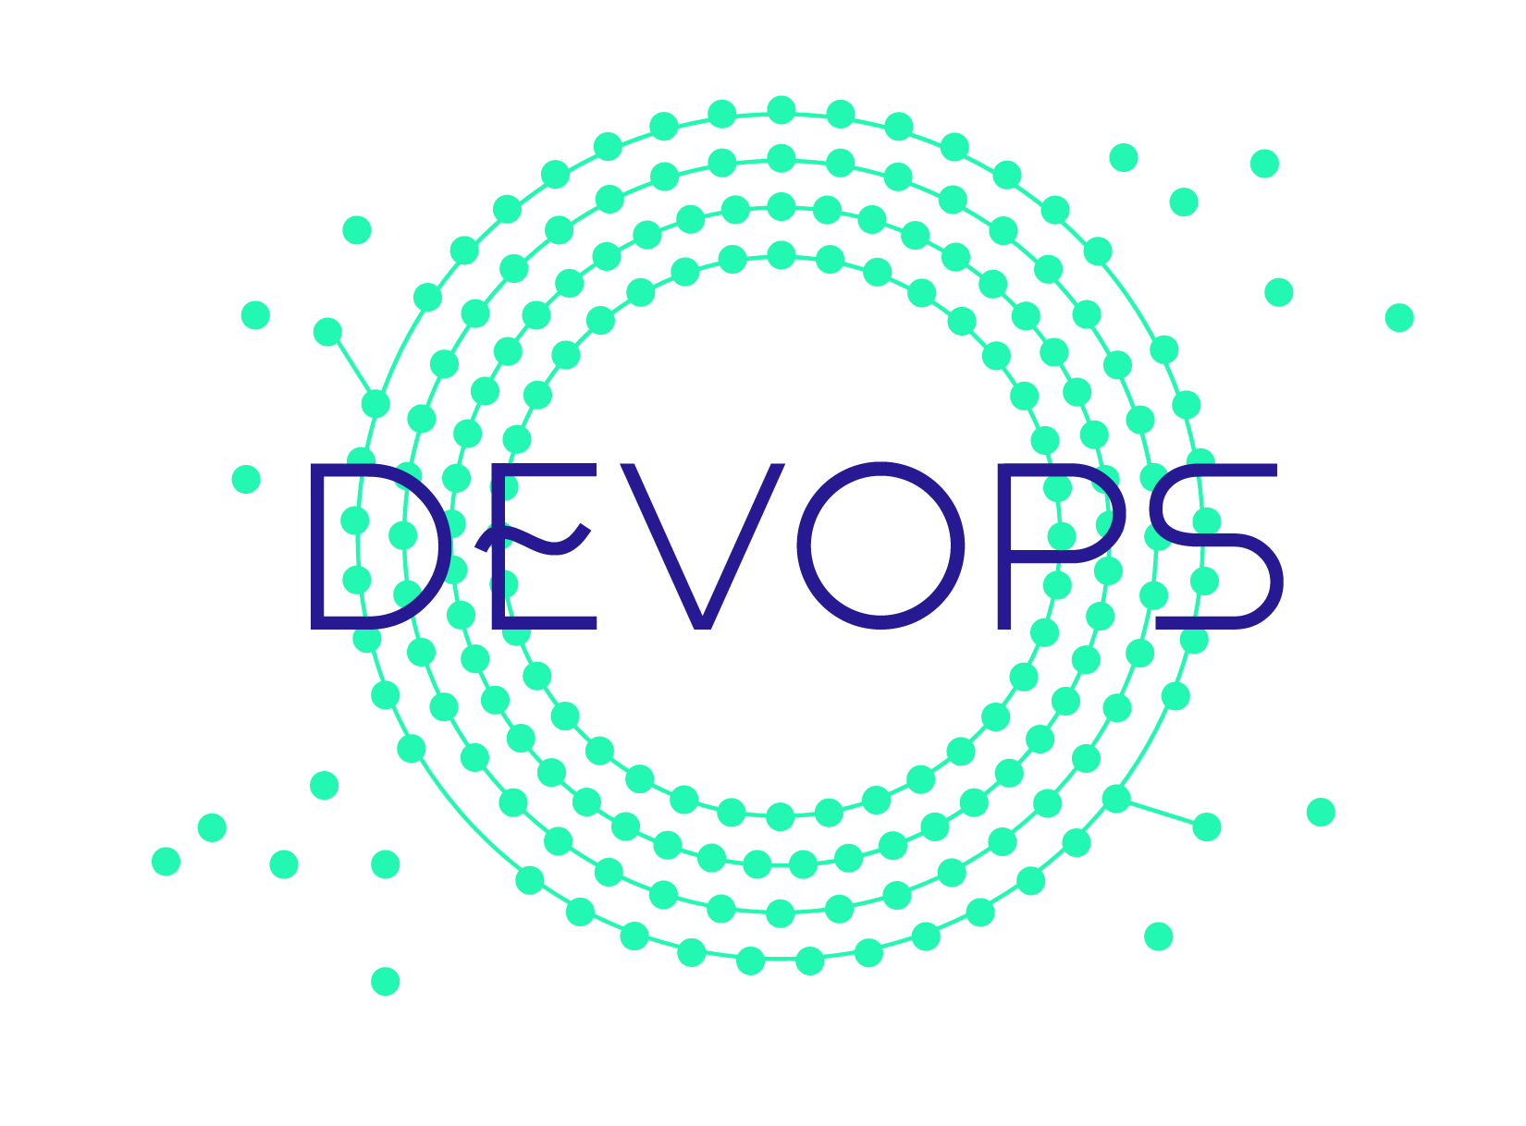
2019 DevOps I.C.I.
V0.4 – updated 09/11/18

Slide 26
2019 ICI – Map to Plan
 | Plan |  | Target $ | Forecast $
 | $ | FTE
2018 | 23.6 | 81 | 23 | 23.5
2019 | 25 | 82 |  | 27
Prioritized Initiatives |  | 2018 |  | 2019 |  | Comments
 |  | $MM | FTE | $MM | FTE
1 | DevOps Development Goal: No-touch DevOps pipelines enabling development teams to go from code to production in 1 hour. | 2.2 | 12 | 2.4 | 13
2 | DevOps Services Goal: Enterprise-grade reliability, performance, security, compliance, and service for Enterprise tools. | 5.2 | 25 | 5.4 | 25
3 | Enterprise Software: Enterprise SCM, CI/CD, Security, Test, Task Mgmt/Collaboration software | 8.0 |  | 9.3 |  | Security software funding required: *Assumes $1.3MM in security software in InfoSec plan
4 | Agile CoE Goal: Drive Agile effectiveness and scaling across RBC | 4.9 | 20 | 3.9 | 14 | 14 FTEs remain after team coach transfer into LOBs in 2019
5 | Automation Solutions Engineering Goal: Automation solutions for DevOps, QE, AppDev community. Full integration with enterprise. | 2.0 | 14 | 2.0 | 14
6 | Process Automation - RPA / NGO Technology Hub Goal: Enable RBC to build & run RPA @ Scale, technology solutions for Intelligent Process Automation | 1.6 | 7 | 1.7 | 7
7 | Developer Experience Goal: Drive solutions through the community to eliminate pain points, improve collaboration, reuse and experience. | 0 | 0 | 0.5 | 1
Sub-Total to 2019 Plan |  | 24 | 81 | 25 | 82
Items Requiring Additional Funding
1 | Enterprise Software: Mainframe IDE / SCM software ( modernize mainframe development & delivery ) |  |  | 1.9 |  | Required to modernize RBC mainframe AppDev (P&CB, I&TS, E&IA, etc.)
Grand Total |  |  |  | 27 | 82
*Enterprise software: Security software for Open Source and security vulnerability scanning – Requires $1.3MM in InfoSec plan or increase to DevOps plan

Slide 27
2019 Mission:
Build Next Gen Solution Delivery capability to help AppDev teams deliver better products, faster.
Desired Outcomes:
Enable RBC to deliver exceptional client experiences with speed and efficiency.
Unlock the potential of our developers. Improve the RBC developer experience.
Drive to delivery excellence.
Notes:
By AppDev we mean teams, programs and organizations that build and deliver software and technology, and includes all cross functional roles ( Dev, Test, Release, PO,…etc )
This is also our customer set, top to bottom, left to right

Slide 28
2019 Initiatives, Capacity, Impact
Initiative |  | Finance Target | Capacity |  | Impact | *Opportunities
 |  |  | $MM | FTE |  | Synergy | Collaboration
1 | DevOps Development Goal: No-touch DevOps pipelines enabling development teams to go from code to production in one hour. | 2.3 | 2.4 | 13 | Faster: Reduce release cycle time by 60% Growth: 300 new apps using pipeline (increase consumption to 75% of target market) | Cloud | Cloud EA DNA
2 | DevOps Services Goal: Enterprise-grade reliability, performance, security, compliance and service for Enterprise tools. | 5.3 | 5.4 | 25 | Better: Reliability, stability, safety baked into the pipeline More Efficient: standard, streamlined ‘paved road’ set of tools to lower enterprise cost
3 | Enterprise Software: Enterprise SCM, CI/CD, Security, Test, Task Mgmt, Collaboration software | 8.5 | 12.5 | 0
4 | Agile CoE Goal: Drive Agile effectiveness and scaling across RBC with an up market focus on programs and larger more complex value delivery organizations. | 5.2 | 4.9 | 19 | Better: Increased effectiveness on team’s coached ( 15% increase in high performing teams) Coaching across 8 scaled program/org initiatives, 50 team initiatives | WM + other LOBs
5 | Automation Solutions Engineering Goal: Automation solutions for DevOps, QE, AppDev community. Full integration of test automation solutions into the DevOps pipeline and enterprise systems. | 2.2 | 2.0 | 14 | Better: Testing and quality fully integrated into pipeline. Simplified, consistent set of supported, fully integrated supporting QE & DevOps. | QE
6 | Process Automation - RPA / NGO Technology Hub Goal: Enable RBC to build & run RPA @ Scale. Define the technology solution for Intelligent Process Automation (RPA+) | 1.4 | 1.7 | 7 | Better: Improved bot resiliency & RPA infrastructure reliability Faster: Accelerated RPA delivery cycle leveraging DevOps and development best practices | WM | DNA WM
7 | Developer Experience Goal: Create a developer community for developers, by developers. Drive set of solutions through the community to eliminate pain points, improve collaboration and experience. | 0 | .5 | 1 | Better: Understanding of the problems that face developer Culture: Help willing participants to collaborate across silos and build a community of knowledge and code sharing | RBC | RBC
Total |  | 25 | 29.5 | 82
29.5 includes the full cost of security and mainframe software
*Synergy = investigating optimization opportunity, funding, org, people, etc.
Collaboration = investigate new ways of working together

Slide 29
DevOps Development – Build new capability, drive adoption
2019 Goal: No-touch DevOps pipelines enabling development teams to go from code to production in one hour.
Initiative |  | Capacity |  | Impact | *Opportunities
 |  | $MM | FTE |  | Synergy | Collaboration
1 | No touch pipelines / automated controls | 0.2 | 1 | Faster: Reduced approval wait time – 2 hrs to 1 min | Cloud | Cloud / Risk / Security
2 | Add pipelines: mainframe, iSeries, containers, etc. | 0.4 | 2 | Faster: More tech stacks supported – approx. 200 Apps |  | GTI
3 | Data: instrumentation, visualization and metrics / performance & productivity | 0.4 | 2 | Better: Visibility in to the pipeline for improvement |  | Cloud / GTI / DNA
4 | Enrich the pipelines: cloud, database as a service, chat bots | 0.4 | 2 | Faster: Reduce wait time for set up | Innovation (Chatbot) | Cloud
5 | Pipeline stability & quality: monitoring, test data, integrated onboarding | 0.2 | 1 | Better: quality baked into the pipeline | DevOps Automation, QE | DevOps Services / GTI
6 | Containers: Windows, security, test automation, DevOps tools | 0.2 | 1 | Better: Next generation infrastructure for the tools |  | GTI
7 | Coaching / support | 0.4 | 2 | Culture: Independent teams
8 | Community (PSG, Champions Program, etc.) | 0.2 | 1 | Culture: Expands support network for DevOps
9 | Adoption squad | 0.2 | 1 | Faster: Accelerate adoption & learning
Total |  | 2.4 | 13
 | $MM | FTE
2018 Run rate |  | 12
*Synergy = optimization opportunity, funding, org, people, etc.
Collaboration = investigate new ways of working together

Slide 30
DevOps Services – Run development software for the Enterprise
2019 Goal: Enterprise-grade reliability, performance, security, compliance and service for Enterprise tools.
Initiative |  | Capacity |  | Impact | *Opportunities
 |  | $MM | FTE |  | Synergy | Collaboration
1 | Compliance: Product ownership, management and coaching for Source Code Management (SCM); Compliance for Infrastructure. | 0.6 | 3 | Source code is the result of all the development work that takes place within RBC and is a major asset protected by various policies. Ensures that source code is protected from unauthorized users and used for the management of source code. Enterprise tool infrastructure is safe and secure with latest patches and upgrades.
2 | Operations & support, reliability, performance, currency | 1.9 | 8 | 30+ Enterprise tools are available and effective to support the AppDev teams to deliver their products
3 | DevOps Tools: Security tooling and support | 0.6 | 2 | Enhanced capabilities for maintaining security of software assets | InfoSec | IT Risk
4 | Automation and simplification: Self-serve capabilities, test automation and simplifying tool suite, tools initiatives | 0.6 | 4 | Better experience for clients, wait time reduced for requests (i.e. Automation of ALM user addition). Faster: reduce manual effort on servicing tickets. Reduce cost to RBC for tools. | DevOps Automation, QE, Perf/Env | QE, Perf/Env
5 | Collaboration tools; Product ownership; Coaching | 0.4 | 2 | Provides the Community with best practices, consistent setup to minimize onboarding time and allow teams to work effectively, quicker. |  | Agile COE
6 | Enablement: Community building – learning, forums, Expo | 0.4 | 4 | App Dev Community can make the most effective use of the tools that will allow quicker adoption and improved productivity. |  | Agile COE
Total |  | 5.4 | 25
 | $MM | FTE
2018 Run rate |  | 25
*Synergy = optimization opportunity, funding, org, people, etc.
Collaboration = investigate new ways of working together

Slide 31
Enterprise Software Expense
Software expense growth driven by:
Automation of development and delivery lifecycle – SCM, Planning, Collaboration, CI/CD, Security, Test,…
Enterprise adoption of new tools/capabilities
Software expense as % of expense growing YTY
Significant growth in 2019 due to:
Security tools transfer from InfoSec. We run and license for T&O but no transfer of budget
Mainframe – modernization of development & delivery with new IDE & SCM. Incur new costs while tools implemented and old tools retired
Continually assess and optimize tool suite
SCM optimization

Slide 32
Enterprise Software – Security Software Growth
Securing the application delivery assembly line in partnership with InfoSec:
Integration of key security capabilities into automated pipeline – Open Source Scanning, Code and Application Security Scanning
Growth in 2019 due to:
Security tools transfer from InfoSec. We run and license the software for T&O but no transfer of budget

Slide 33
Enterprise Software - Source Code Management (SCM) Tool Direction
Growth in 2019 due to:
Mainframe – modernization of development & delivery with new IDE & SCM. Incur new costs while new tools implemented and old tools retired. ISPW will replace Endevor
Continually assess and optimize tool suite
SCM optimization – MKS, SVN, Harvest retirement with migration to GitHub

Slide 34
Agile CoE
2019 Goal: Drive Agile effectiveness and scaling across RBC with an up market focus on programs and larger more complex value delivery organizations.
Initiative |  | Capacity |  | Impact | *Opportunities
 |  | $MM | FTE |  | Synergy | Collaboration
1 | Coaching – Team (50 team-level engagements) | 1.7 | 8 | Teams deliver stable and sustainable solutions, have higher productivity , are persistent and deliver with higher predictability. Organizations, teams and individuals are enabled to effectively practice Agile at the team and program levels and to continuously improve and grow as their needs change and their capabilities mature. | Federation | EA COE Federation
2 | Coaching – Program / Multi-Team | 1.6 | 4 | Larger more complex programs mobilize and execute using Agile practices rather than traditional approaches. Value is delivered to end customers more quickly with higher overall satisfaction. Leadership through team level staff understand and apply Agile practices both at the team level ensuring focus on highest value work first and enabling the ability to re-prioritize work as business and technical needs evolve. | Federation | EA COE Federation
3 | Agile Enablement – AMF, Agile Training, Agile Tools, Agile Metrics Reporting | 0.8 | 4 | Continued elevation Agile adoption progress and metrics through Agile reporting and metrics for board, GE and OC-level consumption. Staff at all levels are more educated in team, program and leadership Agile practices enabling better realization of Agile benefits. Tools like Rally, Jira and Leankit are effectively used across teams and programs to visualize work and increase flow and transparency of key priorities. | L&D T&O PMO DevOps | Enterprise Reporting
4 | Team Maturity and Effectiveness – ASF | 0.4 | 2 | Teams and programs mature their Agile practices enabling them to realized the benefits of Agile more quickly. Teams are able to understand their strengths and weaknesses and can work to resolve impediments and issues which are slowing their progress down | Federation
5 | Community Building – Awareness building through events and communication | 0.4 | 2 | Widely-attended, above average satisfaction and broad absorption of Agile COE events and initiatives drives awareness and deeper understanding of Agile principles and practices, enterprise-wide, leading to greater adoption and Agile maturity resulting in deeper realization of Agile Benefits. | EA COE | EA COE
Total |  | 4.9 | 20
 | $MM | FTE
2018 Run rate |  | 20
*Synergy = optimization opportunity, funding, org, people, etc.
Collaboration = investigate new ways of working together

Slide 35
Automation Solutions Engineering
2019 Goal: Automation solutions for DevOps, QE, AppDev community. Full integration of test automation solutions into the DevOps pipeline and enterprise systems.
Initiative |  | Capacity |  | Impact | *Opportunities
 |  | $MM | FTE |  | Synergy | Collaboration
1 | SIFT product ownership, development and onboarding (supporting 100+ project teams) | 0.6 | 4 | Better/ Faster: meet the evolving demands of the RBC community to automate with a proven enterprise standard
2 | Automation solutions tools, support and mentoring for community (e.g., Full cycle testing - Automate the process of executing all relevant tests against all builds, from lower level to higher level environments) | 0.4 | 3 | Better/ Faster: help teams move faster by building solutions to overcome barriers and challenges in their projects and processes (e.g., ALM connector) |  | QE
3 | Data Hub development – real time test data provisioning across teams | 0.3 | 2 | Better/ Faster: 4th pillar to truly automate testing, gives teams the ability to reference and use real time data for testing purposes. | QE
4 | Environment monitoring & health dashboard & analytics | 0.3 | 2 | Better: ability for teams to monitor and react to environment issues that may affect testing/ project timelines |  | QE
5 | End-to-end automated testing strategy and implementation across platforms and silos | 0.3 | 2 | Silo busting: enable teams to leverage the test assets created by other teams for dependent applications. | QE
6 | Smart Automation (NLP, etc.) | 0.2 | 1 | Better: R&D work to implement Smarter automation |  | WM
Total |  | 2.0 | 14
 | $MM | FTE
2018 Run rate |  | 14
*Synergy = optimization opportunity, funding, org, people, etc.
Collaboration = investigate new ways of working together

Slide 36
Process Automation – RPA / NGO Technology Hub
2019 Goal: Enable RBC to operate RPA technology at scale. Define the technology path/solution for Intelligent Process Automation (RPA+).
Initiative |  | Capacity |  | Impact | *Opportunities
 |  | $MM | FTE |  | Synergy | Collaboration
1 | Support existing labs & new labs (18), Infrastructure support & SWAT | 0.5 | 2 | Faster: Accelerated RPA adoption and delivery |  | GTI
2 | Deliver at Scale: Design, build, enable and support DevOps capabilities for RPA | 0.2 | 1 | Faster: Accelerated RPA delivery cycle leveraging DevOps capabilities |  | WM
3 | Manage at Scale: Strengthen application/bot layer in order to operate, control and manage more effectively at scale (e.g., Elastic). Deliver next generation RPA infrastructure | 0.2 | 1 | Better: Visibility to monitor and proactively manage and avoid incidents; Improved bot resiliency & RPA infrastructure reliability; Cost savings |  | GTI
4 | Develop at Scale: Community of practitioners, Developer Forums, Design reviews, Asset reuse | 0.5 | 2 | Better: Strengthened Community of Practitioners to knowledge-share and improve developer experience; Improved safety and soundness: RPA design principles implemented for bot resiliency, scalability and re-usability |  | WM, I&TS, IT Finance
5 | Intelligent Process Automation – Enable multi-lever approach (RPA/RDA, OCR, data analytics, AI, machine learning, chat bots, etc.) | 0.2 | 1 | Innovation: Enhanced process automation capabilities beyond base RPA |  | DNA, Enterprise Tech. & Document Wkflw, WM
Total |  | 1.7 | 7
 | $MM | FTE
2018 Run rate |  | 7
*Synergy = optimization opportunity, funding, org, people, etc.
Collaboration = investigate new ways of working together

Slide 37

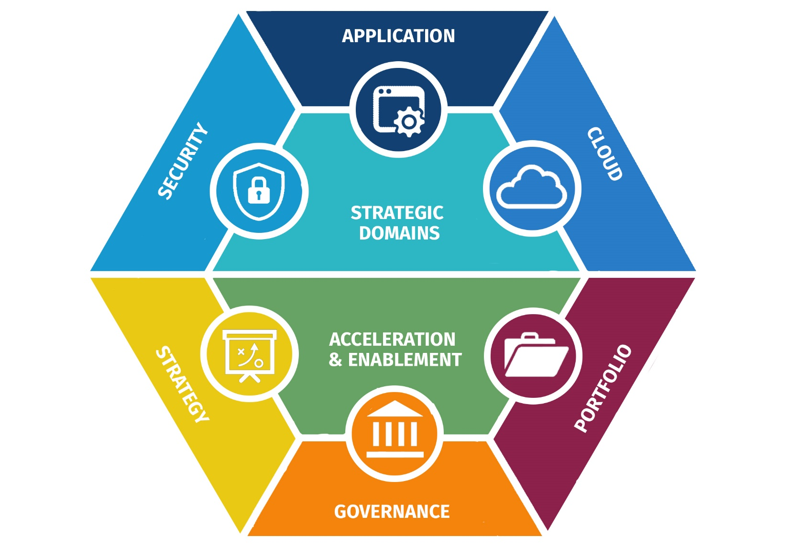
ICI 2019
Initiatives
Global Mandate: Managing technology architecture across enterprise & meet regulatory obligations
Secure the Enterprise: Holistic security management & easy security implementation across the enterprise
Reuse @ Scale: Ease technology adoption across enterprise & deliver target state faster
Core Modernization: Unlock intrinsic value in core assets & evolve core to enable systemic innovation

Slide 38
ICI Summary
2018 Actuals/ Fcst | 48 FTE | NIE $11.0
2019 Plan | 49 FTE | NIE $11.2
*Not including 3 UK architects (part of cloud plan)
** Includes enterprise equipment (software licenses – MSDN, XMLSpy etc) & prof serv $
Priority | Initiative | 2018 FTEs | 2018 NIE $ | 2019 FTEs | 2019 NIE $ | Details | Consumer
1 | EA Global Mandate – BAU: Goal: Managing technology architecture across enterprise & meet regulatory obligations | 11 | 2.2 1.4 (Equipment) | 11 | 2.2 1.4 (Equipment) | Execute & Enhance Enterprise Arch Governance ARB / FAB / TSG Execute & Enhance Enterprise IT Accessibility Standards & Governance Manage the enterprise view of application and technology portfolios (IIPM) EA Operations across Domains and EAO Evolve EA Strategy and practice | All T&O LoB, Audit, Risk Legal, HR, PwD(ERG), Digital T&O Lead Architects, T&O Ops Finance, T&O Ops Enterprise, Architecture Community
2 | Secure the Enterprise: Goal: Holistic security management & easy security implementation across the enterprise | 13 | 2.7 | 14 | 2.9 | Identity (IAM/EIAM) architecture & patterns (full) Cloud, Data-Protect, Cyber-Threat, App & Network Security Arch & Pat (partial) Digital, Data, LoB-Solution security architecture support (partial) Enable enterprise security transformation roadmap Enable Public cloud for the bank - Securing APIs Manage the Use of 3rd party applications/SaaS securely (IMAAC) | GCS, Digital, All LOBs GCS, Cloud, DNA GCS, DNA, Digital, LOBs SAs GCS – Partner with Strategy Leads Cyber Security, Cyber Operations IT Risk, 3rd Party App Owners
3 | Reuse @ Scale: Goal: Ease technology adoption across enterprise & deliver target state faster | 18 | 3.5 | 18 | 3.5 | Enterprise Architecture Governance re-design Cloud Platform Strategy, Architecture & Governance Enterprise conversational platform (chat-bot, VPA, VCA) strat & arch Enterprise CRM strategy/architecture & COE Distributed Application Patterns for IoT, Blockchain and cloud-native Enterprise Security Arch Pattern development (partial) | LoB Dev Teams, Tech Domain Owners CM, WMUS, GAM, Digital Mrkt & Sales CAO, T&O Trans/Strat, P&CB / WM Digital, LoB SalesForce consumers, I&T CM, WMUS, GAM, Digital Mrkt & Sales GCS, LOBs Solution Architects
4 | Core Modernization: Goal: Unlock intrinsic value in core assets & evolve core to enable systemic innovation | 6 | 1.2 | 6 | 1.2 | Identify & prioritize modernization targets to crown jewel apps Establish RBC architecture for Digital Relationship Bank / RBC-as-a-Service Modernize Data Capture from the mainframes Reduce legacy infra cost through app retirement acceleration | T&O LoBs Arch Leads & Strategy T&O LoBs Arch Leads & Strategy T&O LoBs AppDev Teams T&O LoBs Application Owners
Subtotal (Current 2018 FTE & Forecast) |  | 48* | 11 | 49* | 11.2
5 | Secure the Enterprise: Goal: Holistic security management & easy security implementation across the enterprise |  |  | 5 | 1.4 | Cloud, Data-Protect, Cyber-Threat, App & Network Security Arch (full) Digital, Data, LoB-Solution Security Architecture support (full) Server & Endpoint Security Architecture & Patterns Business Critical Process Risk Analysis | GCS, Cloud, DNA, Digital DNA, GCS, LOBs Solution Architects GCS GCS, GRM & LOBs
6 | Reuse @ Scale: Goal: Ease technology adoption across enterprise & deliver target state faster |  |  | 12 | 2.9 | Cloud Platform Engineering & Implementation Cloud Dev-ops & container architecture Security Arch Pattern development (full) Strategic identification of targets for horizontal scaling (past examples: CRM) Measure architecture pattern reuse across enterprise Modernization of Digital Accessibility standards and processes | CM, WMUS, GAM, Digital Mrkt & Sales CM, WMUS, GAM, Digital Mrkt & Sales GCS, LOBs Solution Architects T&O Transformation & Strategy EA & GCS Compliance, Digital, Contact Centre
7 | Core Modernization: Goal: Unlock intrinsic value in core assets & evolve core to enable systemic innovation |  |  | 2 | 0.4 | Modernize App Portfolio, health-check and systems for cloud & dev-ops (IIPM) POC of Machine-Learning on mainframe for sensitive data-sets | T&O LoBs App Owners & Architects T&O LoBs AppDev Teams
8 | EA Global Mandate – BAU: Goal: Managing technology architecture across enterprise & meet regulatory obligations |  |  | 0 | 0.0
Subtotal (Future 2019 FTE Growth & Forecast) |  |  |  | 19 | 4.8 | Note: Includes $1MM Prof Services growth for specific initiatives
Grand Total |  |  |  | 68* | 16.0

Slide 39
ICI Detail – 2019 Initiatives by Team
Security Architecture (1 of 2)
Priority | Initiative | Description | EA Imperative | Capacity |  | Impact
 |  |  |  | $MM | FTE
1 | Cloud Security Architecture | Cloud Security Architecture Development | Securing the Enterprise | 0.4 | 2 | Influence the security transformation roadmap to desired target state to mitigate cyber threat & secure the enterprise
2 | Cloud Security Patterns | Cloud Security Patterns | Reuse @ Scale | 0.36 | 1.8 | Promotes resusable security controls mitigating cyber threat consistently
3 | Security Architecture Reference Implementation | Build out the security architecture in code, not production ready - security as a service and links to cloud ready architecture and development | Reuse @ Scale | 0.4 | 2 | Demonstrates how the architectures will operate in code, links to cloud architecture and control plane development
4 | CIAM Architecture | Customer Identity Architecture | Securing the Enterprise | 0.16 | 0.8 | Influence the security transformation roadmap to desired target state to mitigate cyber threat & secure the enterprise
5 | IAM Architecture Patterns | Patterns development and publishing | Reuse @ Scale | 0.12 | 0.6 | Promotes resusable security controls mitigating cyber threat consistently
6 | EIAM Architecture | Employee Identity Architecture | Securing the Enterprise | 0.16 | 0.8 | Influence the security transformation roadmap to desired target state to mitigate cyber threat & secure the enterprise
7 | Digital Architecture Input | Assisting digital with their new architecture | Securing the Enterprise | 0.1 | 0.5 | Reduce fraud, improve customer experience, enable the business to meet customer requirements
8 | Data Protection Architecture | Data protection architecture developmment | Securing the Enterprise | 0.12 | 0.6 | Influence the security transformation roadmap to desired target state to mitigate cyber threat & secure the enterprise
9 | Data Protection Patterns | Data Protection Patterns | Reuse @ Scale | 0.12 | 0.6 | Promotes resusable security controls mitigating cyber threat consistently
10 | CTM Architecture | Cyber Threat Management architecture development | Securing the Enterprise | 0.12 | 0.6 | Influence the security transformation roadmap to desired target state to mitigate cyber threat & secure the enterprise
11 | CTM Patterns | CTM Patterns Development | Reuse @ Scale | 0.12 | 0.6 | Promotes resusable security controls mitigating cyber threat consistently
12 | Application Security Architecture | Application Security Architecture Development | Securing the Enterprise | 0.16 | 0.8 | Influence the security transformation roadmap to desired target state to mitigate cyber threat & secure the enterprise
13 | App Sec Patterns | App Sec Pattern development | Reuse @ Scale | 0.12 | 0.6 | Promotes resusable security controls mitigating cyber threat consistently
14 | Network Security Architecture | Network Security Architecture Development | Securing the Enterprise | 0.12 | 0.6 | Influence the security transformation roadmap to desired target state to mitigate cyber threat & secure the enterprise
Continued on next page…

Slide 40
ICI Detail – 2019 Initiatives by Team
Security Architecture (2 of 2)
Priority | Initiative | Description | EA Imperative | Capacity |  | Impact
 |  |  |  | $MM | FTE
15 | Server & Endpoint Architecture | Server & Endpoint Security Architecture Development | Securing the Enterprise | 0.57 | 0.6 | Influence the security transformation roadmap to desired target state to mitigate cyber threat & secure the enterprise
16 | Network Security Patterns |  | Reuse @ Scale | 0.12 | 0.6 | Promotes resusable security controls mitigating cyber threat consistently
17 | Server & Endpoint Patterns |  | Reuse @ Scale | 0.27 | 0.6 | Promotes resusable security controls mitigating cyber threat consistently
18 | Security Architecture Strategy/Planning/Managing | Strategy and plan for sec arc | EA Global Mandate | 0.04 | 0.2 | Mature Security Architecture towards target state
19 | EA Strategy/Roadmap/Plan | Strategy and plan for EA | EA Global Mandate | 0.04 | 0.2 | Mature EA towards target state
20 | Solution Architecture Support | Various engagements across the business | Securing the Enterprise | 0.2 | 1 | Adoption of the Enterprise Security Architecture across the bank to mitigate cyber threat and secure the enterprise
21 | Security Consulting Assistance |  | Securing the Enterprise | 0.04 | 0.2 | Supports GCS when assessing applications for cyber security issues
22 | LOB Assistance | Selling archs to the LOBs and getting buyin and helping build | Securing the Enterprise | 0.16 | 0.8 | Build the security architectures across the LOBs
23 | Governance Redesign | EA Governance framework | Reuse @ Scale | 0.04 | 0.2 | Reuse/reduce friction/increase speed/reduce cost/increase ROI/secure the enterprise
24 | FAB Support | architects govern/run FAB | Securing the Enterprise | 0.04 | 0.2 | Promotes common technology platforms for the bank
25 | ARB Support | architects review solutions at ARB | Securing the Enterprise | 0.04 | 0.2 | Reviews solutions for cyber security issues
26 | Business Critical Processes development | Identify critical business processes in P&CB - test case for expansion | Securing the Enterprise | 0.04 | 0.2 | Enables targeted cyber remediation efforts to reduce risk and increase ROI
27 | Measure reusability patterns | request management system for patterns and sec arc engagement | Reuse @ Scale | 0.02 | 0.1 | Track the reuse of patterns (KPIs)
Subtotal |  |  |  | 4.5 | 18 | Growth of 9 from 2018
UK FTE |  |  |  | (0.6) | (3)
Total |  |  |  | 3.9 | 15
 | $MM | FTE
2018 Run-rate* | 1.2 | 6
*Not including 3 UK architects (part of cloud plan),

Slide 41
ICI Detail – 2019 Initiatives by Team
Cloud Architecture
Priority | Initiative | Description | EA Imperative | Capacity |  | Impact
 |  |  |  | $MM | FTE
1 | Cloud Platforms (Private) | Architecture Support for DevOps | Reuse @ Scale | 0.2 | 1 | Deliver faster, automated and secure development lifecycle and release management
2 | Cloud Platforms (Private) | Architecture Support for Private Cloud | Reuse @ Scale | 0.2 | 1 | Deliver faster, automated and secure development lifecycle and release management
3 | Cloud Strategy and Architecture | Container Strategy | Reuse @ Scale | 0.2 | 1 | Own and iterate the strategy on when and how RBC utilizes containers
4 | Cloud Platforms (Public) | Public Cloud Adoption (Intake + Exception Process) | Reuse @ Scale | 0.4 | 2 | Enable Public cloud for the bank
5 | Cloud Platforms (Public) | Public Cloud Application Onboarding / "Professional Services" | Reuse @ Scale | 0.4 | 2 | Enable Public cloud for the bank
6 | Cloud Platforms (Public) | Public Cloud Platform & Pipeline Build (Developer, Control, and Operations Plane) | Securing the Enterprise | 1 | 5 | Enable Public cloud for the bank
7 | Cloud Platforms (Public) | Public Cloud Product Management (Prioritization, Communications) | Reuse @ Scale | 0.4 | 2 | Enable Public cloud for the bank
8 | Cloud Platforms (Public) | Training and Education | Reuse @ Scale | 0.2 | 1 | Own and execute the training and education plans across the program and customer stakeholders
9 | Cloud Strategy and Architecture | Cloud Strategy and Architecture Designs | Reuse @ Scale | 0.2 | 1 | Own and iterate the strategy on how RBC consumes cloud and its architecture vision.
10 | Cloud Application Architecture | CNCF Application Architecture Patterns and Consumables | Reuse @ Scale | 0.2 | 1 | Distributed Application Patterns including IoT, Blockchain and cloud native applications.
Total |  |  |  | 3.4 | 17 | Growth of 7 from 2018
 | $MM | FTE
2018 Run-rate | 2.0 | 10

Slide 42
ICI Detail – 2019 Initiatives by Team
Application Architecture
Priority | Initiative | Description | EA Imperative | Capacity |  | Impact
 |  |  |  | $MM | FTE
1 | Application Architecture - “Consulting Point of Contact for RBC App Teams into EA” | Provide App Architecture expertise / guidance to RBC App Teams via consulting/IAR/ARB, leveraging our expertise and knowledge base within EA (Security, Cloud, also DNA for Data etc). | Core Modernization | 0.3 | 1.5 | Enterprise Architecture patterns/standards are shared and applied across RBC App Teams.
2 | Co-Create Patterns @RBC | Identify opportunities to partner with RBC App Teams and Innovation to Co-Create Patterns. Specifically, these are POCs which are targeted / intended for reuse across RBC. | Reuse @ Scale | 0.2 | 1 | Develop new patterns for RBC to use.
3 | Mainframe Asset Enablement via APIs. | Expose core Mainframe transactions and data (IMS/CICS/DB2/etc) via standard REST APIs using zOS Connect, in addition to IMS call-out pattern. (Co-Create Pattern) | Core Modernization | 0.1 | 0.5 | Simpler/quicker way to expose Mainframe assets as APIs, encouraging innovation. Could replace majority of WebSphere at RBC.
4 | Target Application Architectures | Maintain currency of Target Platform, Dev Frameworks, Capabilities, Tech Standards Architectures, providing an at-a-glance set of ‘map’ for RBC App Teams to know what’s available/coming/being retired at RBC. | Reuse @ Scale | 0.1 | 0.5 | RBC App Teams stay informed on what Application Platforms, Development Frameworks, Tech Standards are used at RBC (Targeted / Buy / Hold / Sell).
5 | Offload Mainframe Data to Distributed for Analytics / Insights | Partner with BP&CC and DNA to POC IBM CDC/IIDR for data capture from IMS/DB2 to distributed OLTP/OLAP data stores. (Co-Create Pattern) | Core Modernization | 0.2 | 1 | Simpler/quicker way (than old way) to push Mainframe data out for analytics, for rapid innovation.
6 | Core Patterns Library | Maintain currency of Application Pattern Library: Event-Driven, Mainframe Integration, Microservices, Web/Mobile, API Gateway. Update/add GIT repo patterns/reference implementations. | Reuse @ Scale | 0.1 | 0.5 | Updated / relevant patterns for consumption by RBC App Teams.
7 | Mainframe Machine Learning Platform | Explore use of z/OS ML engine in DNA and other use cases e.g. Fraud. (Co-Create Pattern) | Core Modernization | 0.2 | 1 | On-premises highly scalable / pay-for-what-you-use machine learning solution. Particularly relevant for sensitive data that must stay on RBC premises.
Total |  |  |  | 1.2 | 6 | Growth of 1 from 2018
 | $MM | FTE
2018 Run-rate | 1.0 | 5

Slide 43
ICI Detail – 2019 Initiatives by Team
Architecture Strategy
Priority | Initiative | Description | EA Imperative | Capacity |  | Impact
 |  |  |  | $MM | FTE
1 | Conversational Platform | Engaged with Enterprise Ops Transformation (CAO) to co-create Enterprise Conversational Platform with WM & P&CB as first chat-bot usecases | Reuse @ Scale | 0.2 | 1 | Establish foundational platform to enable conversational experience (chat-bot, VPA, VCA) at scale for RBC - Enabling rapid implementation and scaling of "post-app" conversational interfaces across LoB
2 | Enterprise CRM / Salesforce | Leading the strategy and architecture for the future of CRM & Salesforce across RBC | Reuse @ Scale | 0.2 | 1 | Enterprise CRM COE to define and manage the enteprise CRM strategy and architecture - Enabling a holistic and consistent view of RBC clients and a scaled integration and analytic capabilities for the business
3 | Governance Redesign | Facilitating the re-design of the Enterprise Architecture governance - across all LoB and Tech Domains to transform Governance for the digital era | Reuse @ Scale | 0.2 | 1 | Re-design and implement architecture-governance a strategic enabler of agile delivery of secure, reusable solutions and services at scale
4 | RBC-as-a-Service Architecture | RBC as a Service & EA Redesign | Core Modernization | 0.2 | 1 | Establish an architecture for the Digital Relationship Bank / RBC-as-a-Service across RBC - Leveraging and aligned to P&CB target arch - enabing solution decisioning consistency and reuse across LoB
5 | Security Research & Communications | Strategy Research & Communications | Securing the Enterprise | 0.05 | 0.25 | Effective communications and community to drive securing the enterprise
6 | Reuse Research & Communications | Strategy Research & Communications | Reuse @ Scale | 0.05 | 0.25 | Effective communications and community to drive reuse @ scale
7 | EA Strategy/Roadmap/Plan | Strategy and plan for EA | EA Global Mandate | 0.05 | 0.25 | Ensure alignment of EA value and impact with T&O and LoB needs
8 | Emerging technology at scale | Research in Academia & Industry Analysts + Partnering with Innovation + Probing across LoB for emerging activity to identify emerging tech to scale | Reuse @ Scale | 0.3 | 1 | Enable the enterprise to scale out innovation PoCs & emerging technologies for use across LoB
9 | Core Research & Communications | Strategy Research & Communications | Core Modernization | 0.05 | 0.25 | Effective communications and community to drive Core Modernization
Total |  |  |  | 1.3 | 6 | Growth of 1 from 2018
 | $MM | FTE
2018 Run-rate | 1.0 | 5

Slide 44
ICI Detail – 2019 Initiatives by Team
Architecture Governance
Priority | Initiative | Description | EA Imperative | Capacity |  | Impact
 |  |  |  | $MM | FTE
1 | Operational Shared Services | Planning, Risk/Audit, Budget, Reporting | Core Modernization | 0.05 | 0.25 | Better: Continuous improvement, dashboard reporting
2 | Governance Ops | ARB, FAB faciliations, projects review and project architecture certifications, | EA Global Mandate | 0.2 | 0.5 | Faster/Agile: to service across T&O domains
3 | Operational Shared Services | Planning, Risk/Audit, Budget, Reporting | Securing the Enterprise | 0.05 | 0.25 | Better:Streamline day-day process
4 | Accessability Ops | Raise awareness and provide consulting across T&O including HR, Legal on Accessibility guidelines. | Securing the Enterprise | 0.5 | 2 | Guidelines in accordance with WCAG 2.1
5 | Accessability Ops | Scale and build new scripts to suppot employee Accomodations | Reuse @ Scale | 0.1 | 0.5 | Build new scripts to support employees with disabilities
6 | Accessability Ops | Provide consulting across T&O including HR, Legal on Accessibility guidelines. Support/Develop Adaptive technology scripts for employee accommodation and QE guidelines. | EA Global Mandate | 0.4 | 1.5 | Improve build new mobile scripts for transofrmation projects
7 | Accessability Ops | Provide consulting across T&O including HR, Legal on Accessibility guidelines. Support/Develop Adaptive technology scripts for employee accommodation and QE guidelines. | EA Global Mandate | 0.1 | 0.5 | Better: Build communications/scripts with new Ontario Accessibility guidelines(Backfill role), more training videos
8 | Operational Shared Services | Planning, Risk/Audit, Budget, Reporting | EA Global Mandate | 0.05 | 0.25 | Streamline day-day process
9 | Governance Redesign | Plan, Facilitate/participate in workshops to redesign Architecture Governance framework for the enterprise | Reuse @ Scale | 0.2 | 1 | Goverance framework to support current technology landscape
10 | Accessability Redesign | Improve IT Accessibility for Agile. Risk based model | Reuse @ Scale | 0.5 | 2 | next generation of agile base IT Accessbility
11 | Operational Shared Services | Planning, Risk/Audit, Budget, Reporting | Reuse @ Scale | 0.05 | 0.25 | Better: Continuous improvement, dashboard reporting
Total |  |  |  | 1.8 | 9 | Growth of 1 from 2018
 | $MM | FTE
2018 Run-rate | 1.6 | 8

Slide 45
ICI Detail – 2019 Initiatives by Team
Portfolio
Priority | Initiative | Description | EA Imperative | Capacity |  | Impact
 |  |  |  | $MM | FTE
1 | Application Health Check Redesign | Confirm best platform and design for prototype content confirmed by 2018 pilot. Complete analysis of triggers for modernization strategies and derive business rules to include in health check outputs. | Core Modernization | 0.3 | 1.5 | Standardize measures for application health, derive where applicable modernization recommendations, prioritize efforts to crown jewel applications and areas requiring enterprise focus (i.e. cost reduction opportunities, technology support end of life, etc).
2 | Application Retirement Acceleration | Speed up the retirement and release of assets by providing transparent view to MoM charges and which charges are costing most to drive needed prioritization and retirement activities. | Core Modernization | 0.2 | 1 | Prioritize retirement and reallocation of highest cost infrastructure components through transparancy of MoM charges. Provide dashboard view to key stakeholders to monitor progress MoM. Resource review to ensure awareness and attention where required.
3 | Dev Tools & Platform Support | Continue to support Java and .Net platforms (incl IDE, xmlspy…) and related development tooling and desktop image deployments (including upgrade to Win 10 | EA Global Mandate | 0.5 | 2.5 | Ongoing enterprise support for development platform and clietn applications.
4 | Driving Application Portfolio Optimization | Community, Engagement, Dashboard Evolution, Data Quality, Detailed portfolio analysis. | EA Global Mandate | 0.6 | 3 | Dedicated engagement of key stakeholders to support application retirements, portfolio reconcilations (optimizations) and provide related measures to conduct enterprise level analysis.
5 | IIPM Ops | Operations for the application portfolio process | EA Global Mandate | 0.5 | 2.5 | Currently there are 1.5 people providing operational support for the 3000+ applications, another is required to support the 500+ being added to the portfolio that currently sit underneath umbrella application records.
6 | IIPM Modernization | Cloud, API, Integration Development, extensions to support 3rd party and technology content to downstream processes, remove appcode dependencies. | Reuse @ Scale | 0.6 | 3 | Provide standard API interfaces to downstream consumers to reduce ongoing interface support to IIPM data. Reconcile across IIPM content for enterprise process needs where differentiation of software provider and hosting is not required. Continue to support enterprise process analysis and redesigns to remove unneeded dependencies to appcodes (e.g. where non-applications are requiring appcodes to fill in forms or track roles within process).
7 | IMAAC | Support and participation of workstream for enterprise program | Securing the Enterprise | 0.3 | 1.5 | Provide continued support to load and extend the external 3rd party provider application inventory and needed data in support of Risk Management, and other enterprise process needs. Provide remaining Solution Architecture support for identified IMAAC 3rd party integrations to address identified regulatory and security control needs.
Total |  |  |  | 3 | 15 | Growth of 1 from 2018
 | $MM | FTE
2018 Run-rate | 2.8 | 14

Slide 46
ICI Detail – 2019 Initiatives by Team
Enterprise Software
Priority | Initiative | Description | EA Imperative | Capacity | Impact
 |  |  |  | $MM
 | Renewal of MSDN License and support | .Net Development support across the enterprise (current MSDN expires in March 2019) | EA Global Mandate | 0.85
 | XMLSpy and other SW licenses | Various SW licenses to support enterprise | EA Global Mandate | 0.05
 | EOS Software | Software for IIPM tool (include dev + maint) | EA Global Mandate | 0.15
 | Research | Seats and licenses for Gartner / Forrester / CISR | EA Global Mandate | 0.35 | Enables access to 3rd party, vendor agnostic research to guide RBC architecture strategy and decisions
Total |  |  |  | 1.4
 | $MM
2018 Run-rate | 1.4

Slide 47
T&O Innovation: ICI
September 2018

Slide 48
T&O Innovation: Proposed Team Capacity – FY2019
Cross-Platform Strategy and Support
Strategic Development & Communications: 2 FTE | Operations: 2 FTE
Capabilities | Blockchain | 2. Security | 3. Voice | 4. Identity | 5. Other | Sub-Totals
 | Payments Reconciliations Trade Finance Tokenization External Networks | Privacy Intelligent Security Authentication Quantum Security | Voice authentication Cross platform voice SecureVoice reuse | IDV Authentication Biometrics | Digital platforms User interfaces IoT
Labs Rapid prototyping UI/UX APIs, microservices | 10 FTE (Transformation) | 4 FTE | 7 FTE | 4 FTE | 2 FTE | 30 FTE
Start-up Partnerships PoC engagements LoB introductions | 0.5 FTE | - | 1 FTE | 1 FTE | 0.5 FTE | 3 FTE
Academic Partnerships IP / research product Access to talent | - | 1 FTE (+ academic research partners) | - | - | - | 1 FTE
Ecosystem Partnerships Branding Access to talent Access to start-ups | - | - | 0.5 FTE | 0.5 FTE | - | 1 FTE
Governance (for COEs) Industry research Benchmarking Enterprise-wide initiative oversight / coordination | 0.5 FTE | - | 0.5 FTE | 0.5 FTE | 0.5 FTE | 2 FTE
Sub-Totals (Totals are Innovation FTE unless otherwise noted) | 11 FTE | 5 FTE | 9 FTE | 6 FTE | 3 FTE | 37 FTE
 |  |  |  |  | Total Innovation & Transformation FTE | 41 FTE (31 Innovation + 10 Transformation)

Slide 49
T&O Innovation
2018 Emerging Forecast | 31 FTE (+7 Blockchain) (+7 vs. Target Forecast) | $5.5MM (+$1.4MM Blockchain) (+$0.1MM vs. Target Forecast)
Initiatives, Cost & Impact
Initiatives & Impact | 2018 Original Plan (Finance) | 2018 Target Forecast (Finance) | 2018 Emerging Forecast (Actual) | 2019 Plan | 2019 Ask
Total FY Budget | $8.4MM ($7.0MM Innovation $1.4MM Blockchain) | $6.8MM ($5.5MM Innovation $1.3MM Blockchain) | $6.9MM (+$0.1MM vs. Blockchain Target) ($5.5MM Innovation $1.4MM Blockchain) | $7.8MM ($5.6MM Innovation $2.2MM Blockchain) | $7.8MM ($5.6MM Innovation $2.2MM Blockchain)
Breakdown by FTE
Emerging Technology Lab Delivering reusable technology solutions to business problems for enterprise use Developing innovation products in partnership with RBC teams and emerging technology companies | 14 FTE | 12 FTE | 14 FTE (+2 Emerging Tech) | 12 FTE | 14 FTE
Blockchain Lab & COE Exploring use cases for blockchain technology in the finance industry Delivering source code for real-world use Building RBC expertise, community and best-practice | 6 FTE | 6 FTE | 7 FTE (+1 early 2019 Hire) | 10 FTE (+4 vs. 2018 Target) | 10 FTE
Cybersecurity Lab Partnering with academic institutions and start-ups Developing security solutions for RBC and the industry Researching and producing original IP to be published or patented | 5 FTE | 5 FTE | 5 FTE | 5 FTE | 5 FTE
Strategy & Operations Managing and leading key initiatives, including COE governance Supporting communication and execution of all RBC innovation strategies Driving adoption and awareness of next-gen technologies across RBC Delivering operational efficiencies for I&T, Innovation | 7 FTE | 3 FTE | 8 FTE (+4 S&O build-out, +1 Amplify hire) | 3 FTE | 8 FTE
Partnerships Matching high-potential start-ups with business needs Building and maintaining connections with the fintech and start-up ecosystem | 4 FTE | 4 FTE | 4 FTE | 4 FTE | 6 FTE
Co-Ops (Year-End) | 2 Co-Op | - | 4 Co-Op | - | 4 Co-Op
Plan (2018 Emerging Forecast, 2019 Plan) | 30 FTE (+6 Blockchain) | 24 FTE (+6 Blockchain) -6 vs. Original Plan | 31 FTE (+ 7 Blockchain) +1 FTE vs. Original Plan +7 FTE vs. 2018 Target | 24 FTE (+10 Blockchain) -7 vs. 2018 Actual | 31 FTE (+10 Blockchain) (+4 Co-Op)

Slide 50
Appendix

Slide 51
T&O Innovation
2018 Target | 12 FTE
2018 Emerging Forecast | 14 FTE (+2)
Initiatives, Cost & Impact: Emerging Technology Lab
Priority | Initiative | Impact | Highlights | Primary Sponsor | Capability
1 | Deliver reusable technology solutions to business problems for enterprise use | Improve client experience; Improve operational efficiencies | Cross-Border App (partnership with FlyBits): designed an application to make it easier for RBC’s Snowbird clientele to spend time in the U.S. and to establish a mobile presence in the U.S. | P&CB John McNain | Location Intelligence
 |  |  | P&CB Pricing Strategy Delivery Tool (partnership with Zafin): delivering the ability to run multiple campaigns simultaneously, and to execute cross-product conditional offers through the Zafin platform to drive new account openings and increase market share | P&CB Jacqui Allard | Business Agility
 |  |  | Digital Identity Verification Solution (IDV): tested leading digital identity verification solutions in partnership with the P&CB Digital Team to select best partner for mobile new client account openings | P&CB Peter Tilton | Identity
 |  |  | Dominion Securities and PH&N Chatbot (partnership with TribalScale): designing a chatbot for WM field advisors to seek information in real-time to reduce calls to head office, and to provide analytics/insights | WM Terence Chow | Conversational UI
 |  |  | Wealth Management Client Onboarding: building a Digital Collaborative Vault for clients to securely store, organize, and share their personal, financial, and legal information, and to assist Wealth Management in selecting a file-sharing provider | WM Dave Malone | Customer Experience
 |  |  | Feedback App: designing an application to gather feedback during RBC town halls and community or employee event | T&O Martin Wildberger | Employee Engagement
 |  |  | Pepper Robot (partnership with SoftBank): evaluating Pepper’s wayfinding and edutainment capabilities, with the goal of being able to use them to greet clients and entertain/educate them in RBC branches | P&CB Bernice Dunsby | Customer Experience
2 | Develop innovation products in partnership with RBC teams and emerging technology companies | Pilot next-gen tech | “RBC Insight” for Voice: developing a PoC for a multi-channel, contextual voice app for institutional clients from existing market research; to be piloted with internal users | WM Jeremy Sonnenburg | Conversational UI (Voice)
Notes:
Lob/enterprise column

Slide 52
T&O Innovation
2018 Target | 6 FTE
2018 Emerging Forecast | 7 FTE (+1)
Initiatives, Cost & Impact: Blockchain Lab & CoE
Priority | Initiative | Impact | Highlights | Primary Sponsor | Capability
1 | Explore use cases for blockchain technology in the finance industry | Test and build maturity in next-gen tech | 2017 Use Case: built cross-border payments shadow ledger blockchain network delivering benefits to intrabank payment operations | T&O Jules Andrew | Blockchain (Cross-Border Payments)
2 | Deliver source code for real-world use | Deliver operational efficiencies | Project Hopper (2018 Use Case): building an MVP that will serve as a system of record for the inter-group Accounts Payable process to deliver a potential/end-state 20+ FTE savings from across the enterprise, while significantly-reducing transaction processing time | T&O Jules Andrew | Blockchain (Payment Reconciliation)
3 | Building RBC expertise, community and best-practice | Recruit and develop best-in-class talent | Blockchain COE and Community of Practitioners: providing thought leadership, consulting services, and a user community for blockchain practitioners across the bank to build in-house expertise. Establishing Enterprise-wide User Forum Building learning pathway on Degreed Developing a blockchain radar for all enterprise blockchain opportunities | Enterprise Martin Wildberger | Blockchain

Slide 53
T&O Innovation
2018 Target | 5 FTE
2018 Emerging Forecast | 5 FTE
Plus: $1.5MM GE Funding for Sponsorships
Initiatives, Cost & Impact: Cybersecurity Lab
Priority | Initiative | Impact | Highlights | Primary Sponsor | Capability
1 | Partner with leading academics and emerging tech companies | Recruit best-in-class talent | Delivering 5 strategic partnerships Established and announced research partnerships with 3 leading academic institutions: University of Waterloo (opening a cybersecurity lab to develop advanced and privacy tools) Ben Gurion University (establishing a presence in Israel and developing advanced cybersecurity techniques) | T&O Martin Wildberger | Quantum Computing & Adversarial Machine Learning
2 | Develop security solutions for tomorrow’s threats | Protect the bank | Delivering a quantum-safe infrastructure for all RBC systems and applications to establish RBC as the first financial institution to widely-deploy quantum protections (‘Quantum Foundation’, in partnership with University of Toronto and University of Waterloo) | WM, T&O Chris Burke, Mike Tardiff | Quantum Computing
 |  |  | Implementing a NIST-accepted, quantum-resilient-certified cryptosystem to simplify the deployment and management of new cryptographic standards and libraries with the goal of developing a seamless method of swapping cryptographic implementation within RBC. | T&O Laurie Pezzente | Quantum Computing
 |  |  | Building a commercially-viable service to homomorphically encrypt data for sensitive data sharing (in partnership with Shield, University of Toronto) | T&O Laurie Pezzente | Homomorphic Encryption
 |  |  | Deploying middleware services to simplify the deployment and management of new crypto standards across RBC | T&O, WM Laurie Pezzente, Chris Burke | Crypto Agility
3 | Research and produce original IP that can be published or patented | Contribute to critical industry research | Filed 4 patents in 2017; 2 in-progress for 2018 Submitted and accepted to Blackhat USA 2018 (scanning the dark web to identify and implement new ways of protecting client data, in partnership with Terbium Labs) Produced a paper to be presented at Asia PKC 2018 Researching avenues for enhancing botnet detection methods that can automatically identify and shut down security threats, recover stolen data, and identify exposure threats before actions are taken by malicious agents (in partnership with University of Darmstadt) | T&O Martin Wildberger | Threat Detection & Identity

Slide 54
T&O Innovation
2018 Target | 3 FTE
2018 Emerging Forecast | 8 FTE (+5)
Initiatives, Cost & Impact: Strategy & Operations
Priority | Initiative | Impact | Highlights | Primary Sponsor | Capability
1 | Support communication and execution of all RBC innovation strategies | Drive strategic alignment across RBC teams | Leading the creation of key strategy papers and presentations for executive audiences: Data Strategy (for the Board of Directors, January 2018) Annual T&O Strategy (for the Board of Directors, May 2018) Cloud Strategy Update (for T&O OC, May 2018) Crypto Asset Update (for GE, June 2018) Data and AI Follow-up (for Board of Directors Offsite, August 2018) Partnering with Corporate Strategy to define strategies and enterprise priorities related to Innovation and emerging technologies Analyzing and reporting on key innovation themes, market developments, benchmarking, etc. to identify areas of opportunity for RBC Hosted first-ever RBC Innovation Offsite (for all other RBC Innovation teams globally) | Enterprise Martin Wildberger | Innovation Strategy Development
2 | Drive adoption and awareness of next-gen technologies across the enterprise | Communicate and share best-practices | Hosting and leading the Crypto Asset Oversight Committee (endorsed by GE) Preparing presentations of key deep-dive topics to the Innovation Council and Enterprise Strategy Office (including Blockchain, Cybersecurity, Emerging Tech, etc.) | Enterprise Martin Wildberger | Deliver Next Gen Technology
3 | Deliver operational efficiencies for I&T and Innovation | Deliver strategic enterprise-wide initiatives | Preparing all executive and managing all operational reporting requirements on behalf of T&O Innovation to drive consistency and process efficiency Leading process re-engineering initiatives on behalf of I&T, as required Established enhanced management reporting formats for I&T (including revised Monthly Business Review Deck, and CIO Navigator Dashboard) | Enterprise Martin Wildberger | Drive Operational Efficiency

Slide 55
T&O Innovation
2018 Target | 4 FTE
2018 Emerging Forecast | 4 FTE
Initiatives, Cost & Impact: Partnerships
Priority | Initiative | Impact | Highlights | Primary Sponsor | Capability
1 | Build and maintain connections with the fintech and start-up ecosystem | Lead ecosystem community engagement | Delivering and managing 45 value-oriented partnerships through 2018 37 partnerships delivered YTD Leading key, multi-year ecosystem sponsorships on behalf of RBC, including: Creative Destruction Labs (Toronto & Montreal), seed-stage program for scaling science based companies Vector Institute, to drive Canadian knowledge in the creation and use of AI OneEleven, supporting high-growth technology companies by bringing together founders to help achieve global success TechTO, hosting 500+ members of the Toronto tech community monthly Signed multiple new community partnerships in Canada and abroad Vector Institute Zone Startups India (Ryerson/SFU/Bombay Stock Exchange) Singularity University Co-Labs | Enterprise Martin Wildberger | Access to Best-in-Class Talent Deliver Fintech ecosystem
2 | Match high-potential start-ups with business needs | Establish partnerships with start-ups | Leading introductions of potential start-up partners to RBC lines of business 315+ meetings completed YTD with potential partners 60+ introductions made to RBC executives YTD Completed Crypto-Asset Competitive Landscape Analysis: leveraged subject matter expertise to support the RBC Value! Initiative, and to build enterprise knowledge of the crypto-asset industry, including an understanding of leading companies, the regulatory environment and activity of large financial institutions and other corporate players | Enterprise Martin Wildberger | Deliver Fintech ecosystem

Slide 56

Cloud ICI

Slide 57
Summary
2018 Actuals/ Fcst | 40 FTEs | NIE $20.9MM
2019 Plan | 45 FTEs | NIE $25MM
Priority | Initiative | 2019 FTEs | 2019 NIE $ | Comments
1 | Keep the lights on | n/a | $2.05MM | Depreciation and infrastructure charges
2 | UK Transit | 5 | $3.20MM
3 | Bluemix | n/a | $4.75MM | Original licenses and 2018 capacity increase, no future increases. FTEs are augmented by GTI.
4 | Private Cloud - Runtimes as a Service (PCF PAAS), Event Streaming as a Service (Kafka), Search as a Service (Elastic) | 18 | $10.60MM | FTEs to be augmented by GTI and GCS. Delaying capacity increases as late possible into the year.
5 | DB as a Service | n/a | $1.25MM | Operated by GTI. FTE to be augmented by GTI.
6 | Program Operations | 9 | $1.81MM | Reduced ask of 4 new FTE down to 2
7 | Private Cloud – 2nd Dev Foundation | n/a | $0.31MM
Base Subtotal |  | 32 | $23.97MM
8 | Public Cloud – AWS: Developer Plane | 10 | $3.30MM
9 | Public Cloud – AWS: Control and Operations Planes | 2 | $5.43MM | FTEs to be augmented by GTI and GCS
10 | Cloud Program Adoption | 10 | $3.73MM
11 | Public Cloud #2 | 12 | $4.44MM
Over Plan Subtotal |  | 34 | $16.90MM
Grand Total |  | 66 | $40.87MM
Program FY2018
FTEs: 40
NIE $: 20.90MM

Slide 58
Summary – A Different Perspective
Category | 2019 FTEs | 2019 Cash $ | 2019 NIE $ | Comments
Compute | n/a | $17.16MM | $13.23MM
Security/Control Plane | 5 | $5.25MM | $5.05MM | FTEs to be augmented by GCS (+10) and excluded from amount
Operations Plane | 5 | $5.29MM | $4.71MM | FTEs to be augmented by GTI (+18) and excluded from amount
Adoption | 10 | $3.73MM | $3.73MM
Rest of Cloud program | 41 | $9.78MM | $14.15MM | UK Transit and Depreciation contribute $5.25MM to NIE
Grand Total | 61 | $41.21MM | $40.87MM

Slide 59
Cloud Initiatives, Cost & Impact
Strategic Initiative | Benefit | Team | Finance | Impact | Synergies
Cloud Program Adoption | Enable teams to modernize applications and make use of open source to reduce cost of ownership and improve speed of delivery Assist application teams with onboarding to cloud through education Establish and promote reusable application patterns for cloud Market and promote cloud program | 10 FTE (+3 YoY) | FTE: Current - $1.26MM Ongoing Incremental - $0.37MM Professional Services (Dev): One time net new - $2.00MM Training/Events: One time incremental - $0.10MM Total: $3.73MM (NIE – $3.73MM) | In 2018: On boarded 166 different app codes to the private cloud platform Trained 494 developers, #2 Slack channel in terms of members, #3 Slack channel in terms of active users making posts in the RBC Technology & Operations workspace Resolved 541 service tickets (support, onboarding, education) in a span of 4 months Organized or participated in 22 events to promote cloud education and promoting the program Reduced time to first dev deployment to an average of 5hrs Regular newsletter to 1148 subscribers, 63% email open rate | DevOps
Program Operations | Provide program vision and strategy Provide operational support across the program Governance of the program Program communications | 9 FTE (+2 YoY) | FTE: Current - $1.26MM Ongoing Incremental - $0.30MM Real Estate Rental: Current – $0.25MM Travel & Training: One time net new - $0.15MM Total: $1.96MM (NIE – $1.81MM) | Ensures execution of the program strategy Provide operational support to enable team to execute strategy Establish communications and relations with other programs and business units
Private Cloud - Database as a Service | Significantly reduce time for developers to obtain a SQL database Provide self serve capabilities for teams to create, test and deploy a database while adhering to governance and change control standards Developers access a new database in minutes versus weeks Developers make changes to databases in minutes versus days | Augmented by GTI | Hardware (GTI): One time net new - $1.00MM Software (GTI): Ongoing net new - $1.00MM Total (GTI): $2.00MM (NIE - $1.25MM) | Required by Omni for delivery of journeys Potential for 1000+ developers to make use of this service Significant demand by application teams especially Digital Presents a significant value proposition to encourage application teams to adopt the platform | GTI

Slide 60
Cloud Initiatives, Cost & Impact
Strategic Initiative | Benefit | Team | Finance | Impact | Synergies
Private Cloud - Runtimes as a Service (PCF PAAS) | Enable application teams to deploy multiple times a day to production through automated change control through a secure highly available self serve infrastructure Improve the SDLC to increase productivity in development by automating processes around bank interaction Reduce the time for application teams to obtain computing capacity versus VM acquisition Reduce security patching time through automated application and OS deployments Enable applications to elasticity scale and deploy with high availability Enable self service monitoring and logging for development teams to operate their applications in production | 10 FTE (+5 YoY) | FTE (Dev): Current - $1.66MM Ongoing Incremental - $0.80MM Hardware: One time incremental - $1.00MM Software: Current - $0.90MM Ongoing incremental - $1.42MM Total: $5.78MM (NIE - $4.84MM) | Required by Omni for delivery of journeys Potential for 2000 developers over the next 5 years to make use of cloud computing approaches and technology Foundational technology for micro services and API reuse Required by Payments Modernization Program, Client Connect (Tool for all branch employees to look up clients info), Enterprise Client Registry (internal lookup for apps for client info) In discussions about support for WealthX initiative In 2018: 68 different app codes using runtimes as a service with 14 active in production Applications include: Account Functions Online Banking (Digital), Target Asset Calculator (I&T), RBC One (E&IA), myBenefits Assistant (I&T), Fund Transfer Microservice (Digital), ClientLink 2 (I&T), Mid Tier Enterprise services including RBC secure APIs (Digital), DevOps Onboarding Portal (I&T) | DevOps, GTI
Private Cloud - Runtimes as a Service (PCF PAAS) : 2nd Dev Foundation | HA for Dev environment Setup closer matches Production Enable HA, load balancing, and DR testing Enable maintenance and upgrades with minimal impact to development activities | n/a | Hardware: One time incremental - $1.24MM Total: $1.24MM (NIE - $0.31MM) | Improved HA and DR testing prior to Production deployment Greater availability of a Dev environment during maintenance and upgrades
Private Cloud - Bluemix | Ability to syndicate IBM cloud services. eg. Watson Able to support WAS based applications in a cloud environment Fully managed solution by IBM | Augmented by GTI | Software: Current - $0.93MM Ongoing incremental - $3.82MM Total: $4.75MM (NIE - $4.75MM) | Continue support for applications currently deployed to Bluemix In 2018: 99 active app codes in Pre-Production, 64 active app codes in Production Applications include: RBC express (Commercial Banking), RBC One (IT&S), My Advisor (Digital), RBC Rewards (Digital), Some UI components of Online Banking (Digital)

Slide 61
Cloud Initiatives, Cost & Impact
Strategic Initiative | Benefit | Team | Finance | Impact | Synergies
Event Streaming as a Service (Kafka) | Enable real time data exchange between applications in a simplified manner Enable a centralizing data stream for applications to retrieve data versus core systems | 3 FTE (+2 YoY) | FTE (Dev): Current – $0.20MM Ongoing incremental – $0.35MM Hardware: One time incremental - $0.50MM Software: Current - $0.77MM Ongoing incremental - $0.40MM Total: $2.22MM (NIE - $1.75MM) | Used by Fraud to protect 4MM daily credit card transactions (Retina/Prism) Required by P&CB target architecture for modernization Required by Payments Modernization Program, CAB Client Appt Booking initiative, D3 Deeper Digital Data,, Bulk Trade Tool for WM, Enterprise Client Registry In discussions about support for WealthX initiative In 2018: 53 different app codes using event streaming as a service Teams have made use of capability to start reducing reliance on mainframes Applications include: Digital Shared Services (Digital), Retina (E&IA), Prism (E&IA), Event Standardization Service (I&T), DevOps & Automation Tools (I&T) | DNA
Search as a Service (Elastic) | Provide self service high-performance, distributed search and analytic flexibility Enable a alternative source for data retrieval versus core systems reducing workloads while providing developer flexibility | 3 FTE (+1 YoY) | FTE (Dev): Current - $0.40MM Ongoing incremental - $0.20MM Hardware: One time incremental - $0.50MM Software: Current - $0.65MM Ongoing incremental – $0.20MM Total: $1.95MM (NIE - $1.48MM) | Required by Digital for 7 year transaction history for web and mobile banking Required by Payments Modernization Program, OMNI, Enterprise Client Registry In 2018: 37 different app codes using search as a service Teams have made use of capability to start reducing reliance on mainframes Applications include: I&TS Data Lake (E&IA), Retina (E&IA), Event Standardization Service (I&T) | DNA
Private Cloud – Control Plane | Enhance security and regulatory controls across the private cloud platform Standardize implementation of controls | 2 FTE (To be augmented by GCS) | FTE (Dev): Current - $0.36MM Professional Services One time development - $0.33MM One time consulting - $0.33MM Software: Ongoing net new - $0.67MM Total: $1.69MM (NIE - $1.69MM) | Ensure cloud platform and components are ready for audit | DevOps, GCS

Slide 62
Cloud Initiatives, Cost & Impact
Strategic Initiative | Benefit | Team | Finance | Impact | Synergies
Private Cloud - Operations Plane | Enhance operational capabilities with cloud compatible tools and processes Enhance operational tools for logging, monitoring, billing, capacity management resiliency Enhance operational processes for integration into exist service management practices | To be augmented by GTI | Professional Services: One time development - $0.06MM One time consulting - $0.06MM Software: Ongoing net new - $0.60MM Hardware: One time net new - $0.50MM Total: $1.22MM (NIE - $0.84MM) | Ensure operational excellence for 153 applications operating on the private cloud platform | DevOps, GTI
Public Cloud #1 (AWS) – Developer Plane | Ensures RBC remains competitive and increases its rate of innovation Modernize application development where RBC developers have access to the most innovative technologies through self serve infrastructure Enables developers to utilize managed services for reducing time to delivery (e.g., storage, compute, streaming, static content hosting, object storage, etc.) Drives cost effectiveness in the utilization of pay-per-use compute for “burst” workloads / applications and large offline storage | 10 FTE (+9 YoY) | FTE (DEV): Current - $0.18MM Ongoing incremental - $0.84MM Professional Services: One time development - $1.5MM One time consulting - $0.50MM Software: Ongoing incremental - $0.28MM Total: $3.30MM (NIE - $3.30MM) | Developers have access to the largest ecosystem of productivity tools and services 2019 Will reduce application processing time for FRTB by 66% (calculation is reduced from 6 to 4 hours) Will enable the foundation for a public cloud data lake to increase insights for competitive advantages Will enable the use of cloud services to assist in machine learning and data analytics Agility to prove out use cases / new solutions – verifying functionality and rationality quickly, before investing substantial time and cost. This enables the business to focus on legitimate solutions and use cases and invest minimal time in Proof of Concepts. | DevOps, DNA, GTI

Slide 63
Cloud Initiatives, Cost & Impact
Strategic Initiative | Benefit | Team | Finance | Impact | Synergies
Public Cloud #1 (AWS) – Control and Operations Planes | Delivers the control plane, to secure applications and infrastructure deployed in public cloud Supports the operational plane, to optimize operational management through reuse and standardization Improves utilization of infrastructure and software licensing, through the use of pay-per-use models and shifting from capital to operating expenditures | 2 FTE (To be augmented by GTI and GCS) | FTE: Current - $0.36MM Professional Services: One time development – $1.90MM One time consulting - $0.60MM Software: Ongoing net new - $2.00MM Hardware: One time incremental - $0.60MM Network connections: Current - $0.42MM Total: $5.88MM (NIE - $5.43MM) | Assisting GCS Designing and implementing public cloud compatible security: Identity federation Threat monitoring, Security Incident Management Compliance and Vulnerability Scanning Penetration Testing, Network Protection, and Endpoint Protection Compliance Monitoring Secrets Management, Certificate Management Assisting GTI Designing and implementing public cloud compatible operations: Billing, Chargeback, and Cost Optimization Asset Management Centralizing Logging, Centralized Monitoring Incident Management Networking (eg. DNS and direct connectivity) Account and Access Management Security at Scale Code driven deployments for security ensure auditability / transparency and enable developers to easily request changes through code Reducing Operational Overhead Server less, event-driven AWS pipelines minimize operational overhead (no patching / OS upgrades required) and costs ($~3 per month) Focusing Developers on business value Enterprise application pipeline drives developer productivity, by abstracting security and operations, and enabling them to focus on application development only | DevOps, GCS, GTI
Public Cloud #2 – Developer, Control, and Operations Planes | Delivers a secondary platform for Cloud Service Provider arbitrage aligned to the banks multi cloud strategy Offers niche / differentiated service offerings from Public Cloud #1 (AWS) for developer productivity | 12 (+12 YoY) | FTE: Ongoing net new - $0.79MM Professional Services: One time development - $1.60mm One time consulting - $0.90mm Software: Ongoing net new - $1.00MM Hardware: One time net new - $1.20MM Total: $5.49MM (NIE - $4.44MM) | Driving Developer Services Increasing the breadth of managed services available for developers, including niche / specialized provider-specific services | DevOps, DNA, GTI, GCS
Overall (Total) |  | 61 FTE (+34 YoY) | $41.21MM (NIE - $35.62MM)

Slide 64
Private Cloud PAR Funding | Developer Plane
Hardware costs are to ensure sufficient capacity is available to accommodate anticipated growth of use across Runtimes, Event Streaming, Database, and Search services.
Establish an additional development environment to enable HA and DR of the existing development environment
Software costs include:
Licensing of Pivotal Cloud Foundry, Confluent Kafka, Elastic Cloud Enterprise to accommodate anticipated growth
Licensing of software needed to support Database as a Service
Professional Services include:
Development of a developer portal and supporting pipelines to improve developer productivity
Development of a training portal to aid in developer education and adoption
Training / Events include:
Attending various events to educate people about and promote the program
Providing training / education events including leveraging external subject matter experts
FTE increase to ensure sufficient levels of resources to provide engineering as well as support capacity

Slide 65
Private Cloud PAR Funding | Control & Operational Plane
Hardware costs are to ensure operational excellence of the private cloud
Additional infrastructure hardware such as networking equipment to support increased adoption and use cases
Software costs include:
Licensing of software needed to implement Control plane features
May be introduction of new software or increase licensing costs of existing solutions
Licensing of software needed to implement Operational plane features
May be introduction of new software or increase licensing costs of existing solutions
Professional Services include:
Subject matter experts to provide assessments and guidance on Control and Operational plane implementations
Support the development of Control and Operational plane implementations
FTE increase to ensure sufficient levels of resources to provide engineering and operational capacity

Slide 66
Public Cloud PAR Funding | Developer Plane
Hardware costs are not applicable, as the Cloud Service Provider is responsible for the hardware
Software costs include:
Continuous Integration / Continuous Delivery (CI/CD) – Jenkins or equivalent
Configuration Management – Ansible Tower or equivalent
Source Code Repository – Github Enterprise
Artifact Repository – Artifactory or equivalent
API Gateway – Apigee or equivalent
Professional Services include:
80% - System integrators to enhance the application pipeline for new services (as per roadmap). This may include Sourced, O#, etc.
20% - Cloud Service Provider professional services for guidance and assessments (AWS, Azure, and GCP)
Consumption accounts for the Cloud Service Provider service costs (estimated at 1.5X of the current monthly run rate incurred by application teams), which will be charged back to the users
FTE includes the following teams (at an estimated salary of $150,000):
Internal “Professional Services” to gather customer requirements and integrate / onboard them to the platform
Adoption to guide customers through the Exception Process
Platform Engineers / Site Reliability Engineers to build and enhance the platform for new services (as per roadmap)

Slide 67
Public Cloud PAR Funding | Control Plane
Hardware costs are not applicable, as the Cloud Service Provider is responsible for the hardware
Software costs include:
Compliance and Vulnerability Scanning – Tenable Nessus or equivalent
Penetration Testing
Threat Monitoring – AWS GuardDuty or equivalent
Compliance Monitoring – Evident or equivalent
Network Protection – Akamai
Endpoint Protection – McAfee and Crowdstrike, or equivalents
Secrets Management – HashiCorp Vault, Cyberark, or equivalent
Identity Federation
Certificate Management – HashiCorp Vault, Cyberark, or equivalent
Code Quality Analysis and Security Code Scanning – SonarQube and Veracode, or equivalents
Professional Services include:
System integrators to enhance the control plane for new services (as per roadmap)
Cloud Service Provider professional services for guidance and assessments
External auditors for platform assessments (Deloitte, E&Y)
Consumption accounts for the Cloud Service Provider service costs (estimated at 1.5X of the current monthly run rate incurred by security services), which will be charged back to the users
FTE includes the following teams (at an estimated salary of $150,000):
Cloud Security Architects
Cloud Security Operations Developers (DevSecOps)

Slide 68
Public Cloud PAR Funding | Operations Plane
Hardware costs include the set up of a dedicated network connection from RBC to the Cloud Service Provider (CSP) – Direct Connect or equivalent
Software costs include:
Billing, Chargeback, and Cost Optimization – Cloudability or equivalent
Asset Management
Centralizing Logging
Centralized Monitoring
Professional Services include:
System integrators to enhance the operational plane for new services (as per roadmap)
Cloud Service Provider professional services for guidance and assessments
Consumption accounts for the Cloud Service Provider service costs (estimated at 1.5X of the current monthly run rate incurred by operational services), which will be charged back to the users
FTE includes the following teams (at an estimated salary of $150,000):
Cloud Operations

Slide 69
QE 2019 ICI
Initiatives, Capabilities, and Impact
September 18, 2018

Slide 70
Quality Engineering (QE) - ICI Summary
2018 Actuals/ Fcst | 23 FTEs | NIE $5.6
2019 Plan | 23 FTEs | NIE $6.4
Initiative (Prioritized by Focus Area) |  | 2018 |  | 2019 |  | Impact | Synergy
 |  | $MM | FTE | $MM | FTE
1 | Environment | 1.0 | 5 | 1.1 | 6 | Production insights applied to development cycle; right sizing the environment infrastructure and understanding availability Better access management with reduced environment downtime; greater use service virtualization; faster backup & restore cycles; capturing change failures Applications are designed to meet Performance & Scalability objectives
1.1 | Environment Health Check / Dashboard Goal: Reduce Environment downtime, promote efficient use of resources and ability to scale | 0.2 | 1 | 0.5 | 3 |  | DevOps & Cloud
1.2 | Predictive Capacity Management Goal: Business transaction level predictive analytics to forecast performance based on environment and influencers | - | - | 0.2 | 1
1.3 | Proactive Application Level Monitoring Goal: Enable an engineering mindset through insight driven development/planning | 0.8 | 4 | 0.4 | 2
2 | Data | 1.1 | 6 | 0.9 | 5 | Protection & Management of test data and integration to DevOps pipeline Fact based means to drive productivity improvements & strengthening QE practices within the development cycle
2.1 | Data as a Service – Data Hub, Test Data Virtualization & Deployment Goal: Accelerated access to relevant test data and reduced back up and storage times | 0.4 | 2 | 0.2 | 1 |  | DevOps
2.2 | Analytics & Insights Driven Productivity Framework Goal: Define, develop and implement productivity framework for developers and testers | 0.7 | 4 | 0.7 | 4
3 | Products & Tooling | 0.4 | 2 | 0.4 | 2 | Greater trust in test automation through the reduction of false positives and high failure rates Eliminate the development step to automation & Performance Engineering
3.1 | Automation & Performance Solution Engineering (Support Libraries & Starter Packs) Goal: Reduction of upfront automation effort and promote reusability across different automation frameworks integrated with the DevOps Pipeline | 0.4 | 2 | 0.4 | 2 |  | DevOps
4 | Practice & Enablement | 1.9 | 10 | 2.0 | 10 | Improved stability, resilience and recoverability of production systems Improved solution delivery velocity through reduced ambiguity in specifications and early detection of defects Horizontal integration between testing, product management and development community
4.1 | Establish Site Reliability Engineering Practice Goal: Reduced overall risk of system failure in production due to improved resilience | 0.2 | 1 | 0.5 | 2
4.2 | Test & Behavior Driven Development Goal: Greater efficiency & shorter release cycles through collaboration and early course correction | 0.8 | 4 | 0.8 | 4
4.3 | Learning, Coaching, Consulting, & Supplier Management Goal: Drive solutions through the community to eliminate pain points and improve collaboration | 0.9 | 5 | 0.7 | 4
5 | Enterprise Software – Licenses & Tools | 1.2 | - | 2.0 | -
Totals |  | 5.6 | 23 | 6.4 | 23
70

Slide 71
Initiative 1: Environment
2018 Actuals/ Fcst | 5 FTEs | NIE $1.0
2019 Plan | 6 FTEs | NIE $1.1
Initiative |  | Highlights | Stakeholders
1.1 | Environment Health Check & Dashboard Goal: Reduce Environment downtime, promote efficient use of resources and ability to scale | Wealth Management POC with 3 applications completed Prepare tool rollout within WM and HRM Planning Prepare material and train release managers and test environment users on the tool as well as the change release management process Establish baseline and track reduction in test environment downtime incidents due to communication issues; also collect user feedback on existing tool features and desired future capabilities Plan for future enhancements to the dashboard – further automate currently environment management tasks (e.g. online booking of environment activities as required etc.) | DevOps team and WM WM, DevOps team, HR and Procurement WM, DevOps team, HR and Procurement WM, DevOps team, HR and Procurement DevOps team and LOBs
1.2 | Predictive Capacity Management (Leveraging Machine Learning & AI) Goal: Business transaction level predictive analytics to forecast performance based on environment and influencers | Finalize POC agreements for Predictive Capacity Management using Machine Learning (AI) Run POC and assess the tool’s machine learning (AI) predictive capabilities to generate future estimates where any future consumption which exceeds a configurable threshold is exposed as a capacity event, reporting and modeling Train the application teams on the usage of the tool On completion of successful POC, scale across the enterprise with GTI upon agreement | WM and GTI WM and GTI Application teams WM and GTI
1.3 | Proactive Infrastructure & Application Level Monitoring & Analytics (functional & non-functional) Goal: Enable an engineering mindset through insight driven development/planning | Executive Dashboard & Analytics Portal developed for all LOB’s Code profiling and pre-production analytics capabilities at scale | LOBs, QE Analytics and Insights Team LOBs, QE Analytics and Insights Team

Slide 72
Initiative 2: Data
2018 Actuals/ Fcst | 6 FTEs | NIE $1.1
2019 Plan | 5 FTEs | NIE $0.9
Initiative |  | Highlights | Stakeholders
2.1 | Data as a Service – Data Hub, Test Data Virtualization & Deployment Goal: Accelerated access to relevant test data and reduced back up and storage times | API redesign DDA Enhancements VSA Enhancements OLN Enhancements* - Loans credit lines OLM Enhancements* Mortgages Data Utilities – Create Profile* Scaling to WM* Virtualization and compression of test data *Tools/frameworks are targeting Fiscal 2020 given the current funding allocation | Automation Solutions Engineering GTI and DBAs
2.2 | Analytics & Insights Driven Productivity Framework Goal: Define, develop and implement productivity framework for developers and testers | Design and socialize the productivity framework Data collection and baseline calculations Validation and roll-out Fine-tuning and enhancements | QE CoE and LoBs

Slide 73
Initiative 3: Products & Tooling
2018 Actuals/ Fcst | 2 FTEs | NIE $0.4
2019 Plan | 2 FTEs | NIE $0.4
Initiative |  | Highlights | Stakeholders
3.1 | Automation & Performance Solution Engineering (Support Libraries & Starter Packs) Goal: Reduction of upfront automation effort and promote reusability across different automation frameworks integrated with the DevOps Pipeline | Development and delivery of the automation capabilities: Cucumber automation framework Protractor automation framework* Jasmine ALM connector* SoapUI ALM connector Cucumber ALM connector SoapUI Scriptless Framework* SoapUI Scripted Framework* Architecture Proposal for End to End Banking Automation *Tools/frameworks are targeting Fiscal 2020 given the current funding allocation | QE Practice team Automation Solutions Engineering Automation Solutions Engineering Automation Solutions Engineering QE Practice team Automation Solutions Engineering Automation Solutions Engineering Automation Solutions Engineering

Slide 74
Initiative 4: Practice & Enablement
2018 Actuals/ Fcst | 10 FTEs | NIE $1.9
2019 Plan | 10 FTEs | NIE $2.0
Initiative |  | Highlights | Stakeholders
4.1 | Establish Site Reliability Engineering Practice Goal: Reduced overall risk of system failure in production due to fewer production incidents | Define Governance Model and key SRE roles SRE key pillars confirmed (Resilience, Performance and Scalability, Release engineering, Production incidents) and methodology reviewed (SRE key pillars, ownership, success criteria and measure of success) with LoB Execute SRE methodology for POC, review results with LoB, and update SRE methodology based on feedback | LOBs and GTI LOBs QE Analytics and insights, LOBs
4.2 | Test & Behavior Driven Development Goal: Greater efficiency & shorter release cycles through collaboration and early course correction | Cucumber automation framework created BDD training materials developed in collaboration with product and DevOps teams Coaches identified, trained, and BDD introductory workshops conducted Rollout BDD to selected pilot teams and monitor success (Number of products/projects completed, reduction in defects, higher automation passing rate test throughput) Update BDD framework in collaboration with pilot teams based on feedback | LOBs and Automation team DevOps & Requirements COE Agile & Requirements COE LOBs LOBs, QE Analytics and Insights Team
4.3 | Learning, Coaching, Consulting, & Supplier Management Goal: Drive solutions through the community to eliminate pain points and improve collaboration | Program QE assessments and recommendations completed and presented to program BU/ leadership team Report on overall QE program dashboard and close communication gaps across silo teams Touch points with BU/ leadership teams to meet metrics targets and highlight risks Improve/ add horizontal integration automation and DevOps Assessment and recommendation of current code coverage, unit and integration test Deliver hands-on training, workshops and learning assets on QE transformational capabilities; Community building – forums, events, communications Partner with Technology Supplier Management team on contract extensions and new RFPs | Program teams (SmartATM, ECI/ Client 360, GTI DevOps ART, CPR, POS) Program teams, CoE Analytics & Insights Program teams Program teams, Automation Solutions Engineering, and DevOps LoB development teams LOBs, Agile and DevOps COE, Practitioners LOBs, GSM, Procurement and the Business

Slide 75
5. Enterprise Software – Licenses & Tools
2018 Actuals/ Fcst | NIE $1.2
2019 Plan | NIE $2.0
Note:
 | IBM RIT** | Maintenance costs to be confirmed with vendor for 2019
 | BDD*** | BDD tools currently being evaluated

